Slide 1
Basics of Formal Ontology

Slide 2

INSTRUCTOR
John Beverley, PhD
Co-Director, National Center for Ontological Research
Assistant Professor, University at Buffalo
Associate Director, Institute of AI and Data Science
CEO, Acacia Knowledge Systems Inc.

Slide 3
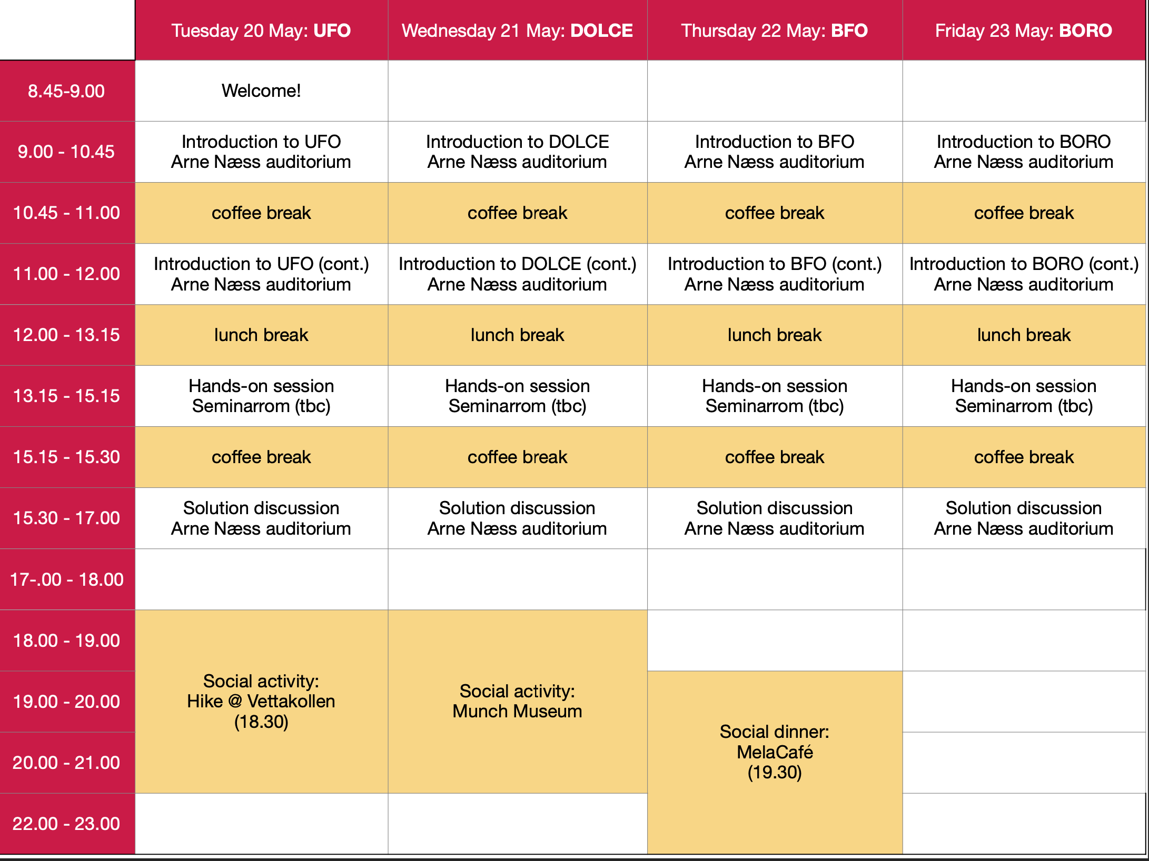

Slide 4
Outline
Module 1: Motivation for Ontology Engineering
Module 2: Motivation for Basic Formal Ontology
Module 3: Theory of BFO
Module 4: Building Ontologies with BFO
Module 5: Exercises

Slide 5
Outline
Module 1: Motivation for Ontology Engineering
Module 2: Motivation for Basic Formal Ontology
Module 3: Theory of BFO
Module 4: Building Ontologies with BFO
Module 5: Exercises

Slide 6
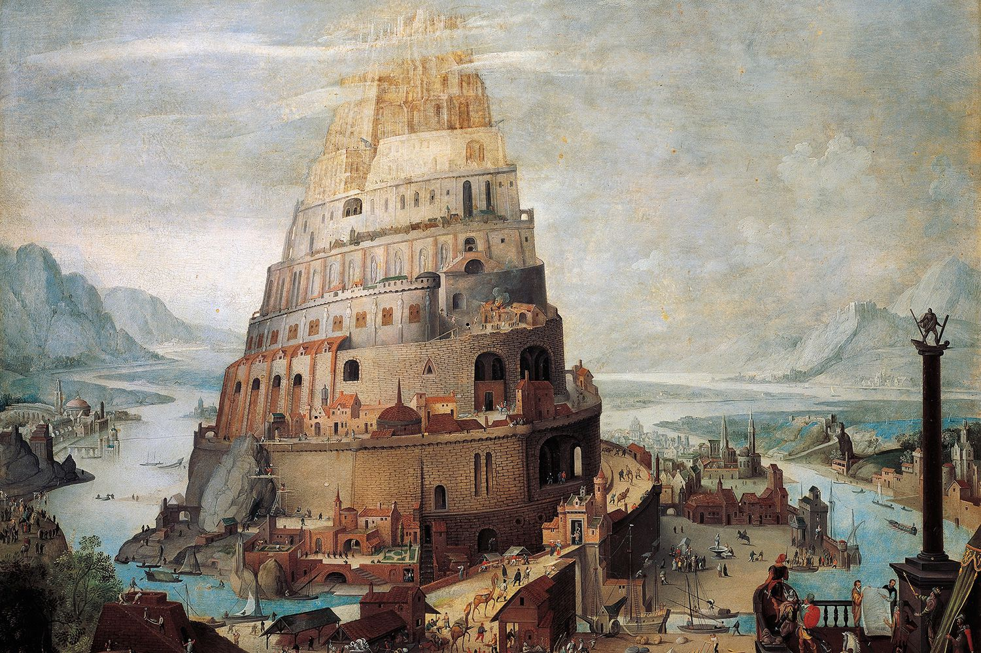
Information Silos
An information silo is an information repository, e.g. management system, database, the content of which cannot be integrated with that of other information repositories using standard computing strategies

Slide 7
Information Silos
An information silo is an information repository, e.g. management system, database, the content of which cannot be integrated with that of other information repositories using standard computing strategies
SILOS ARE DANGEROUS

Slide 8
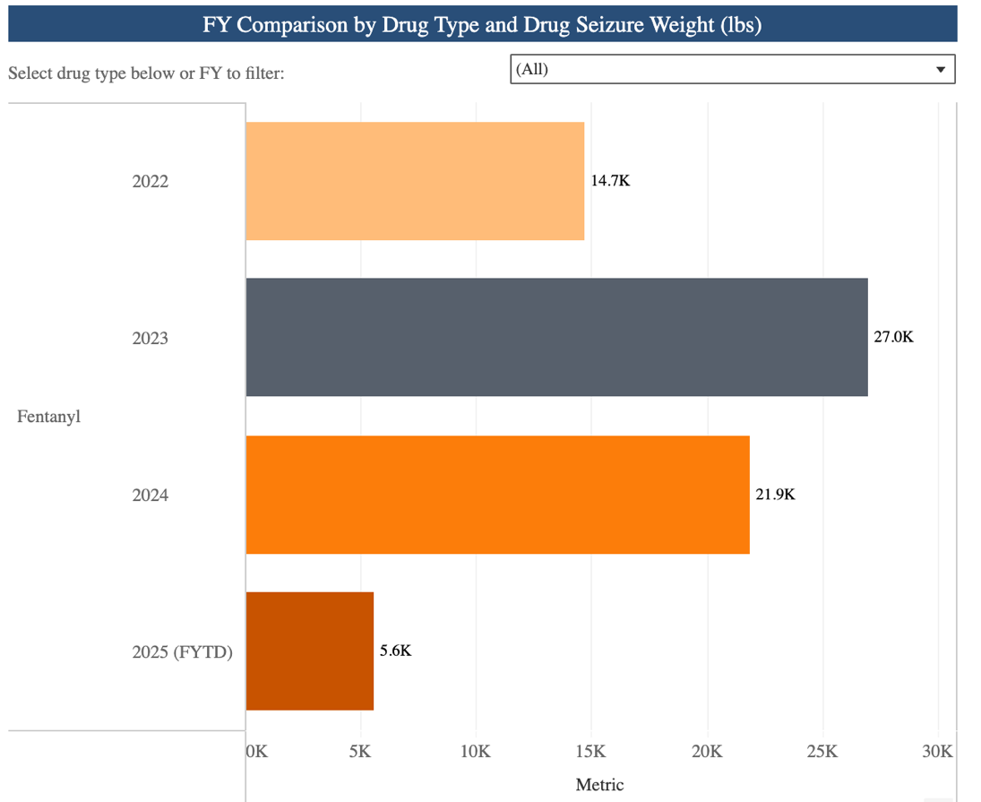
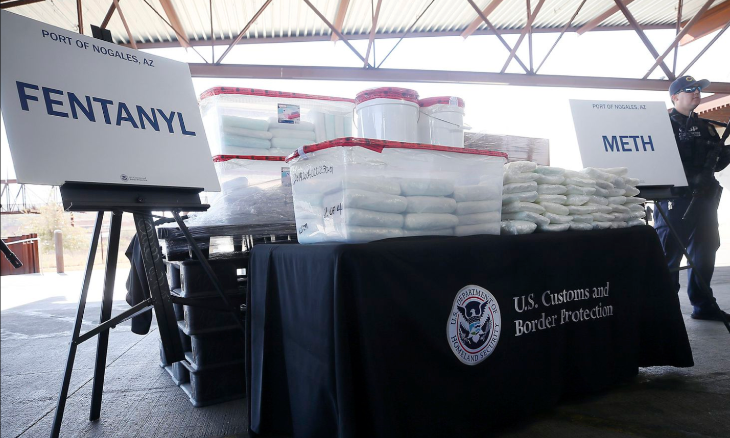
Smuggling Narcotics
Accurate and efficient fentanyl tracking across US borders is undermined by high volume of siloed data

Slide 9
Information Silos
An information silo is an information repository, e.g. management system, database, the content of which cannot be integrated with that of other information repositories using standard computing strategies
SILOS ARE EXPENSIVE

Slide 10
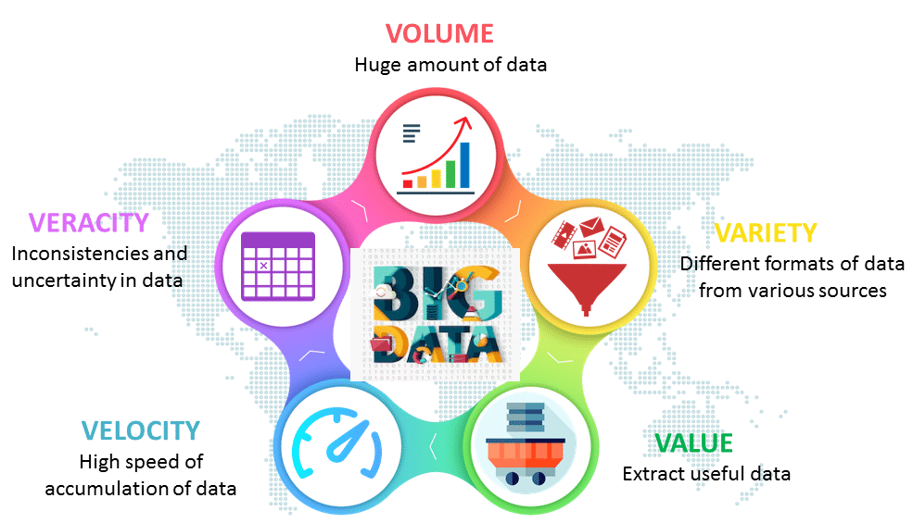
Cost of Silos
A 2020 report by NIST estimated the lack of interoperability across industrial datasets costs companies between 21-43 billion
McKinsey estimates mid-size companies spend 20-50 million annually due to silos

Slide 11
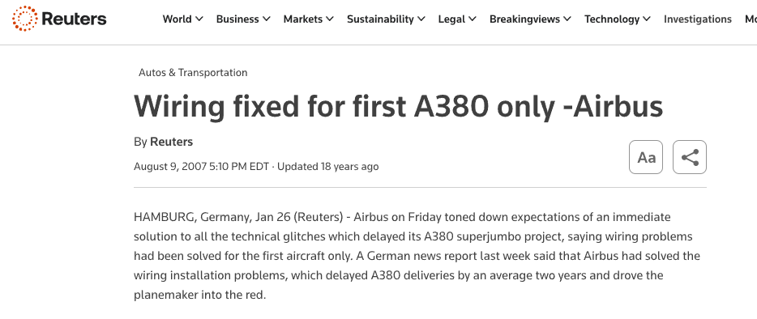
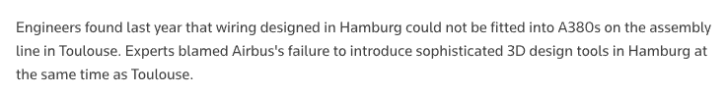

Slide 12
Information Silos
An information silo is an information repository, e.g. management system, database, the content of which cannot be integrated with that of other information repositories using standard computing strategies
SILOS ARE EVERYWHERE

Slide 13
Information Silos
An information silo is an information repository, e.g. management system, database, the content of which cannot be integrated with that of other information repositories using standard computing strategies
HOW DO WE ADDRESS THEM?

Slide 14
Interoperability Strategies
For the sake of argument, let us call “interoperability strategies” those strategies that mitigate or eliminate information silos
Interoperability strategies may be divided along at least three axes
Machine-Machine
Human-Human
Human-Machine
Notes:
Promote the reuse of domain knowledge from other ontologies, through a common formal language: OWL
Internationalized Resource Identifiers (IRIs) promote tracking of entities and cross-ontology references, support interoperability
Promote human-human, human-computer, and computer-computer communication
Enable automated inference useful for deriving implicit information, as they effectively connect parts of taxonomies to other parts of taxonomies in machine-readable ways

Slide 15
Machine-Machine Interoperability
Involves addressing the more familiar information silos
Associated interoperability strategies often emphasize common metadata standards, business logic, APIs, etc.
Any two heterogeneous information systems share some underlying formal structure
Notes:
Promote the reuse of domain knowledge from other ontologies, through a common formal language: OWL
Internationalized Resource Identifiers (IRIs) promote tracking of entities and cross-ontology references, support interoperability
Promote human-human, human-computer, and computer-computer communication
Enable automated inference useful for deriving implicit information, as they effectively connect parts of taxonomies to other parts of taxonomies in machine-readable ways

Slide 16
Human-Human Interoperability
Involves addressing what we might call social silos, which undermine consistent communication among agents
Human-Human Interoperability strategies often emphasize consensus-building exercises, dictionaries, evaluation of natural language, etc.
Any two speakers of a given natural language share some underlying formal structure
Notes:
Promote the reuse of domain knowledge from other ontologies, through a common formal language: OWL
Internationalized Resource Identifiers (IRIs) promote tracking of entities and cross-ontology references, support interoperability
Promote human-human, human-computer, and computer-computer communication
Enable automated inference useful for deriving implicit information, as they effectively connect parts of taxonomies to other parts of taxonomies in machine-readable ways

Slide 17

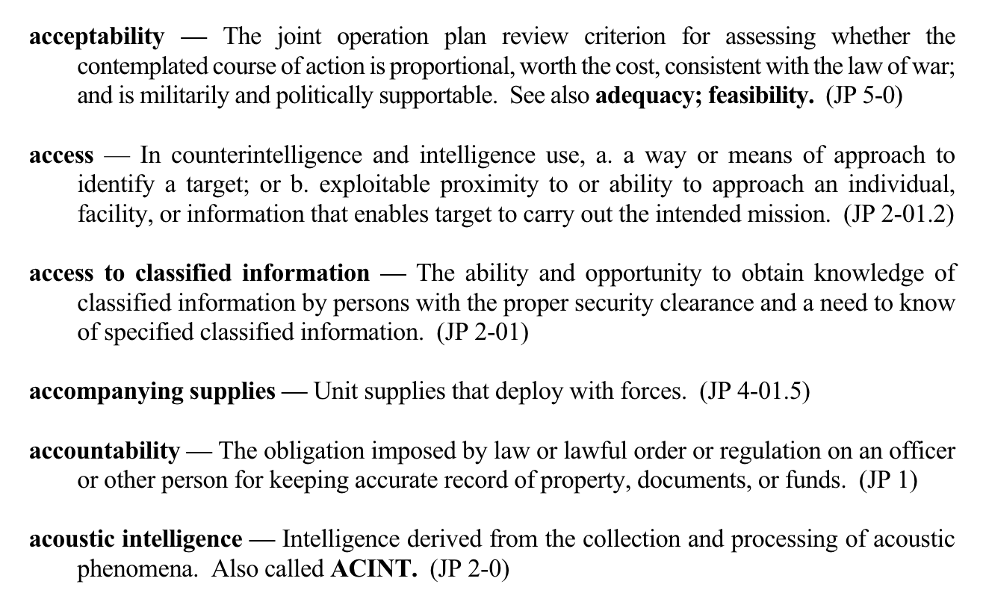
FOR HUMANS

Slide 18
Human-Machine Interoperability
Involves encoding human-human interoperable solutions in a machine-readable manner
Associated interoperability strategies often emphasize data schemas, ontologies, knowledge graphs, etc.
Any two heterogeneous information systems share some underlying formal structure
Notes:
Promote the reuse of domain knowledge from other ontologies, through a common formal language: OWL
Internationalized Resource Identifiers (IRIs) promote tracking of entities and cross-ontology references, support interoperability
Promote human-human, human-computer, and computer-computer communication
Enable automated inference useful for deriving implicit information, as they effectively connect parts of taxonomies to other parts of taxonomies in machine-readable ways

Slide 19
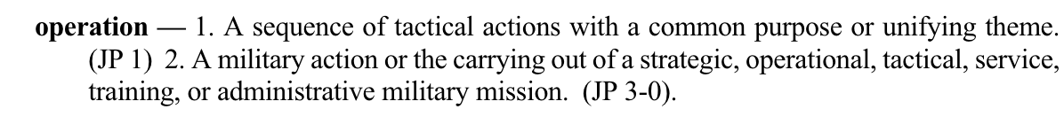
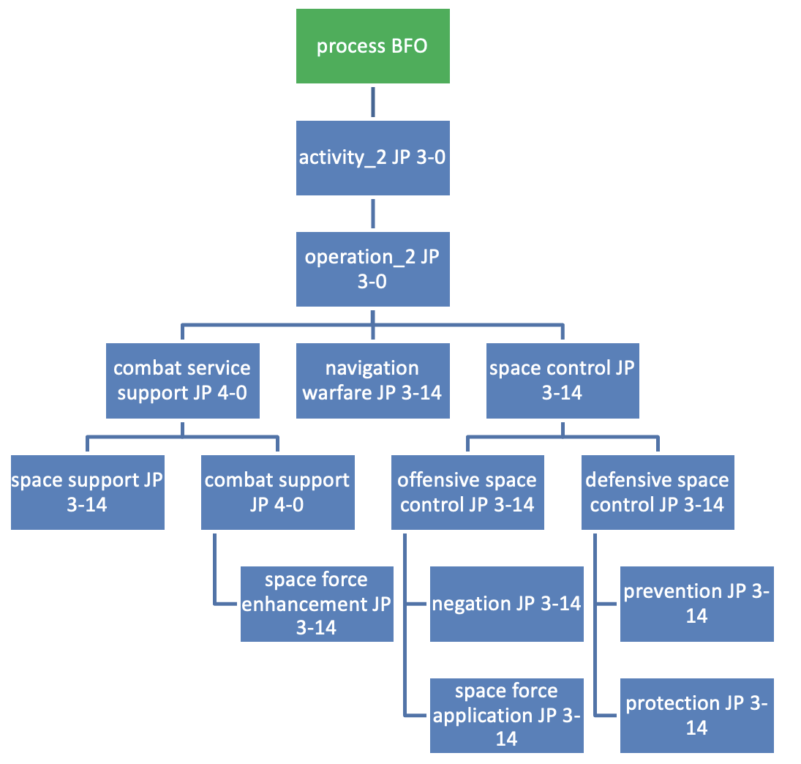
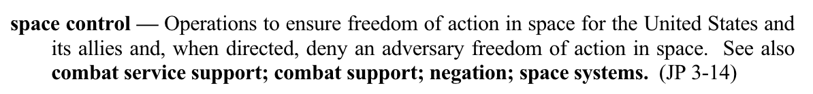
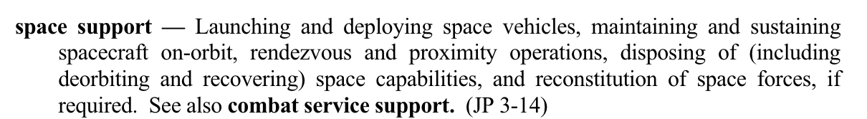
FOR MACHINES

Slide 20
Information Silos
An information silo is an information repository, e.g. management system, database, the content of which cannot be integrated with that of other information repositories using standard computing strategies
INTEROPERABILITY STRATEGIES ARE NOT NEW

Slide 21
Promise of Ontology Engineering
Ontologies are formally well-defined machine-interpretable controlled vocabularies designed to represent entities and logical relationships among them
Ontologies make explicit the implicit meanings buried in datasets, by using basic principles of formal logic
Ontologies provide a semantic layer to connect information silos
Notes:
Promote the reuse of domain knowledge from other ontologies, through a common formal language: OWL
Internationalized Resource Identifiers (IRIs) promote tracking of entities and cross-ontology references, support interoperability
Promote human-human, human-computer, and computer-computer communication
Enable automated inference useful for deriving implicit information, as they effectively connect parts of taxonomies to other parts of taxonomies in machine-readable ways

Slide 22
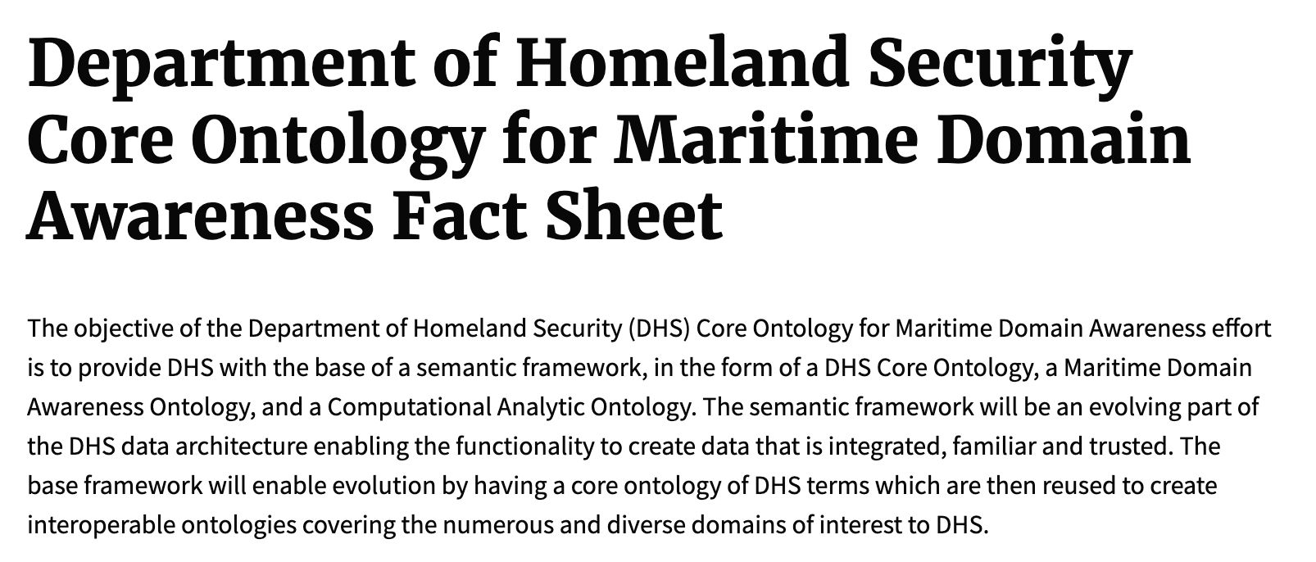
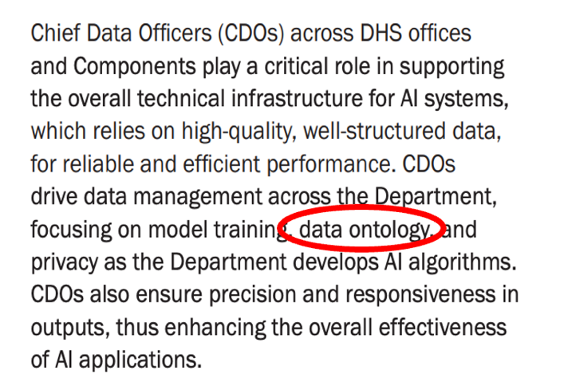





Slide 23
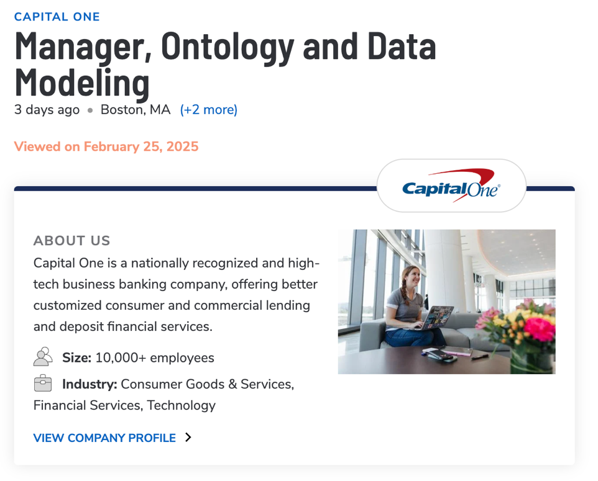
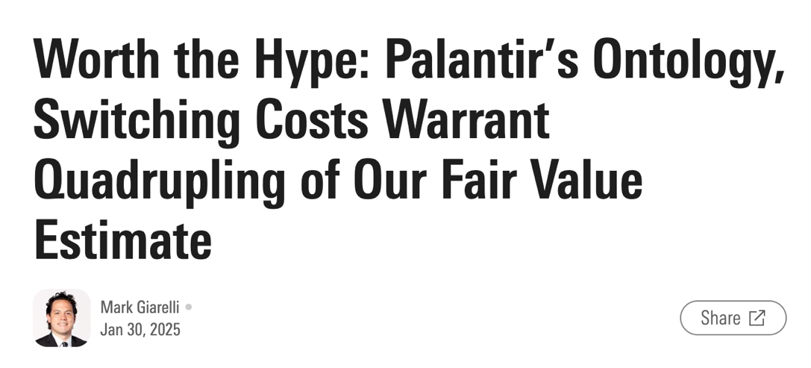


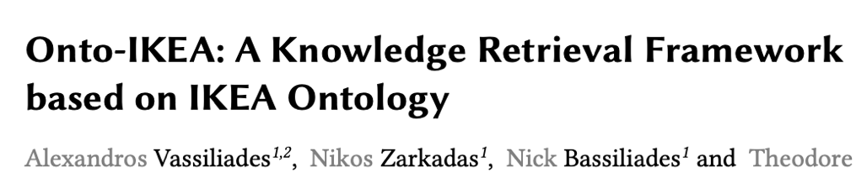





Slide 24


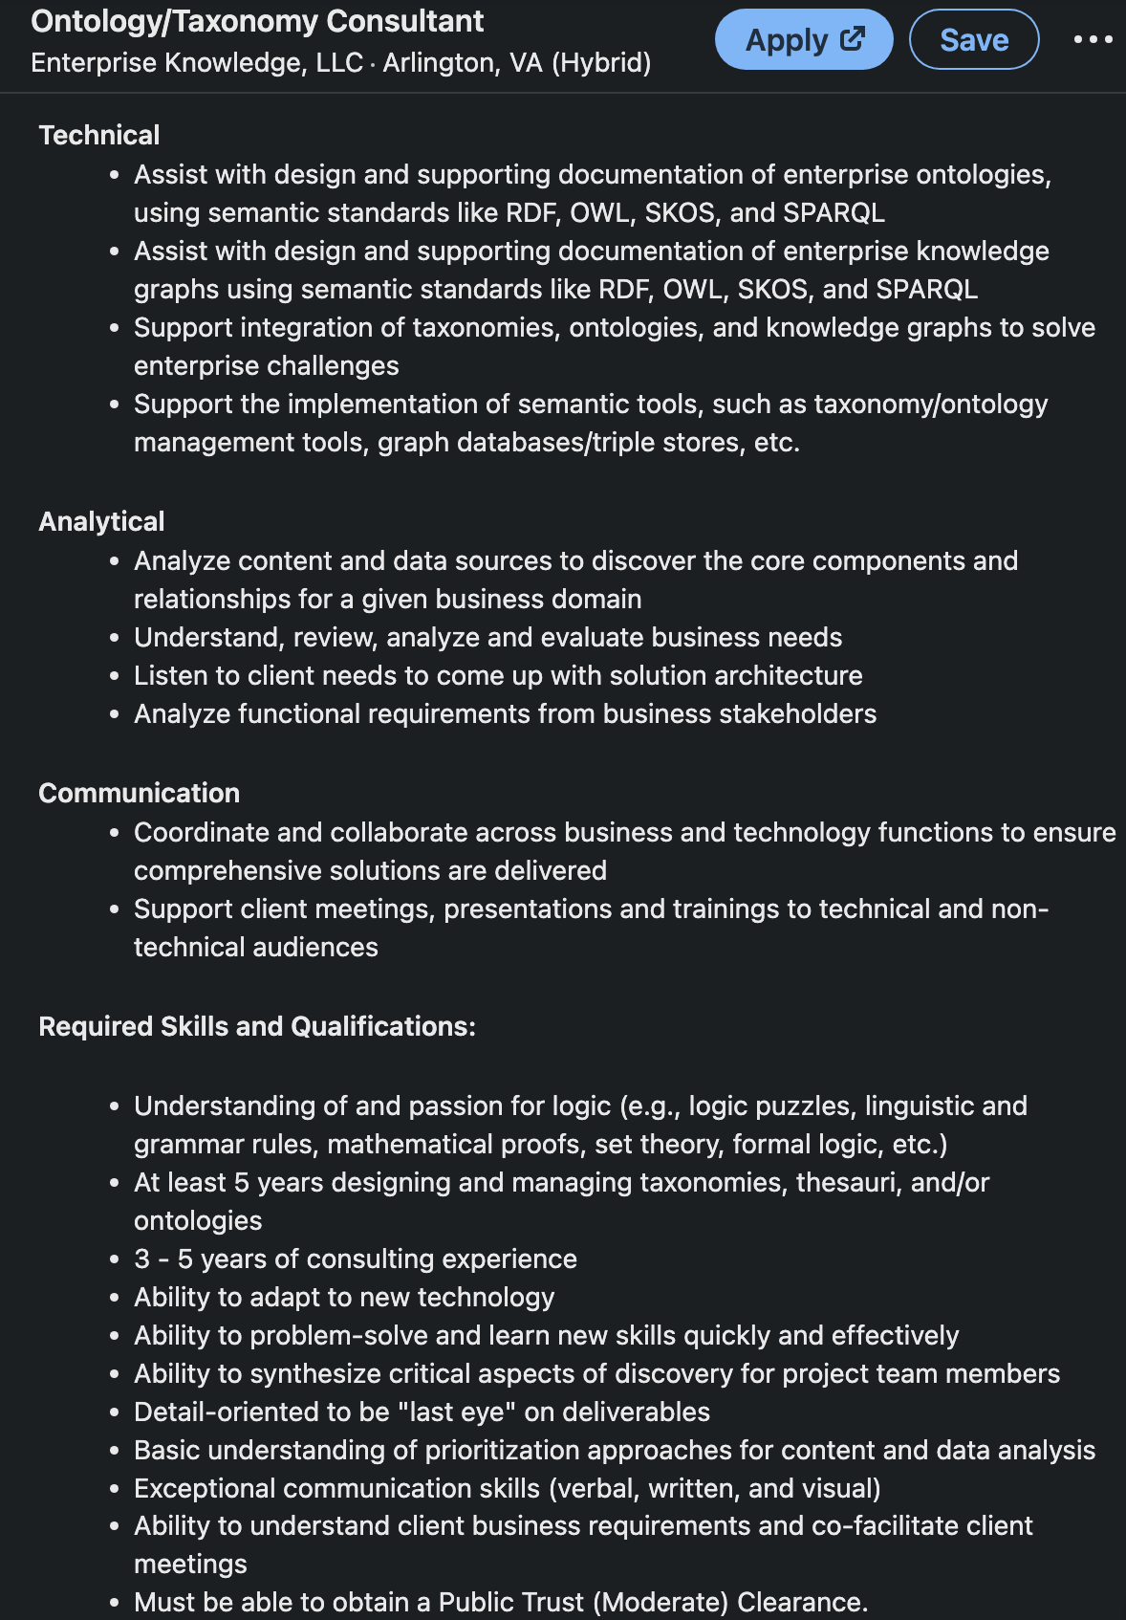






Slide 25
Outline
Module 1: Motivation for Ontology Engineering
Module 2: Motivation for Basic Formal Ontology
Module 3: Theory of BFO
Module 4: Building Ontologies with BFO
Module 5: Three Use Cases

Slide 26
CERTAIN INTEROPERABILITY STRATEGIES SUPPORT IMPROVED DATA QUALITY BETTER THAN OTHERS

Slide 27
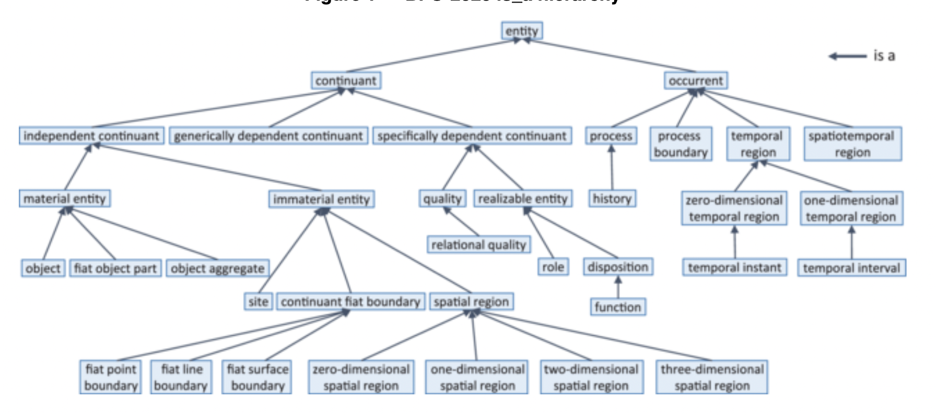

Slide 28
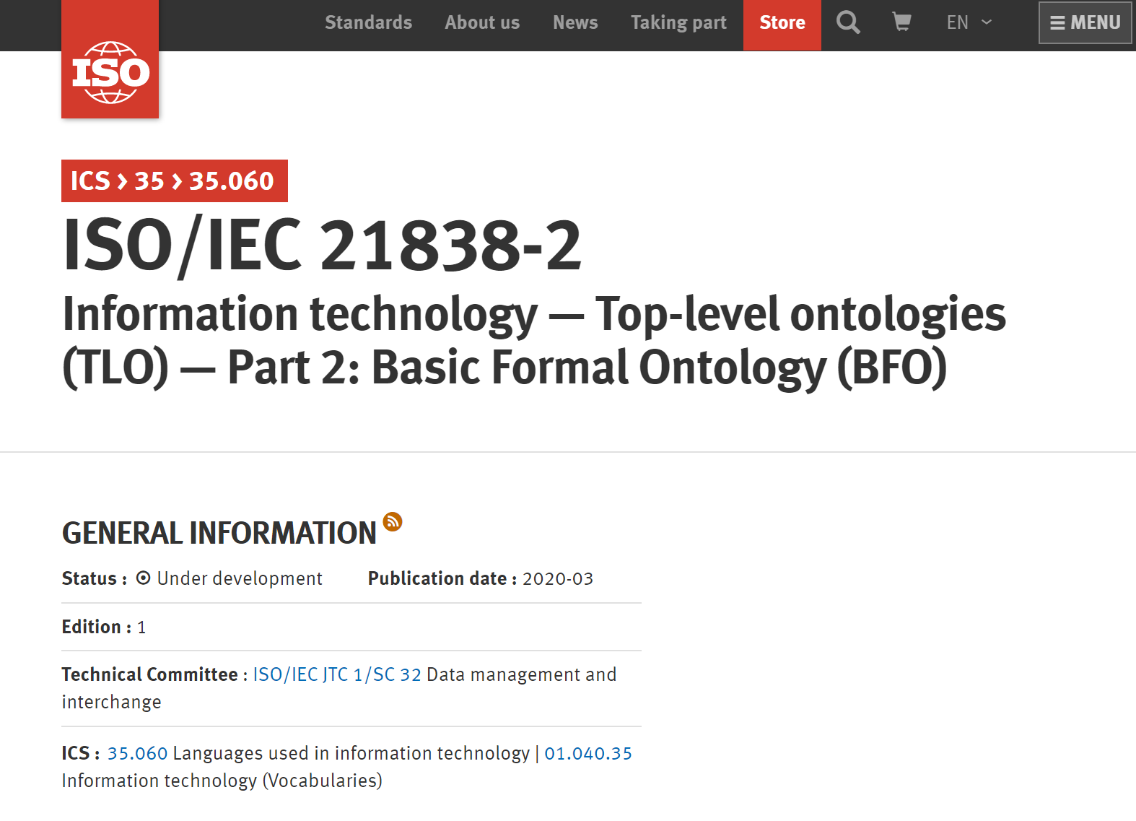
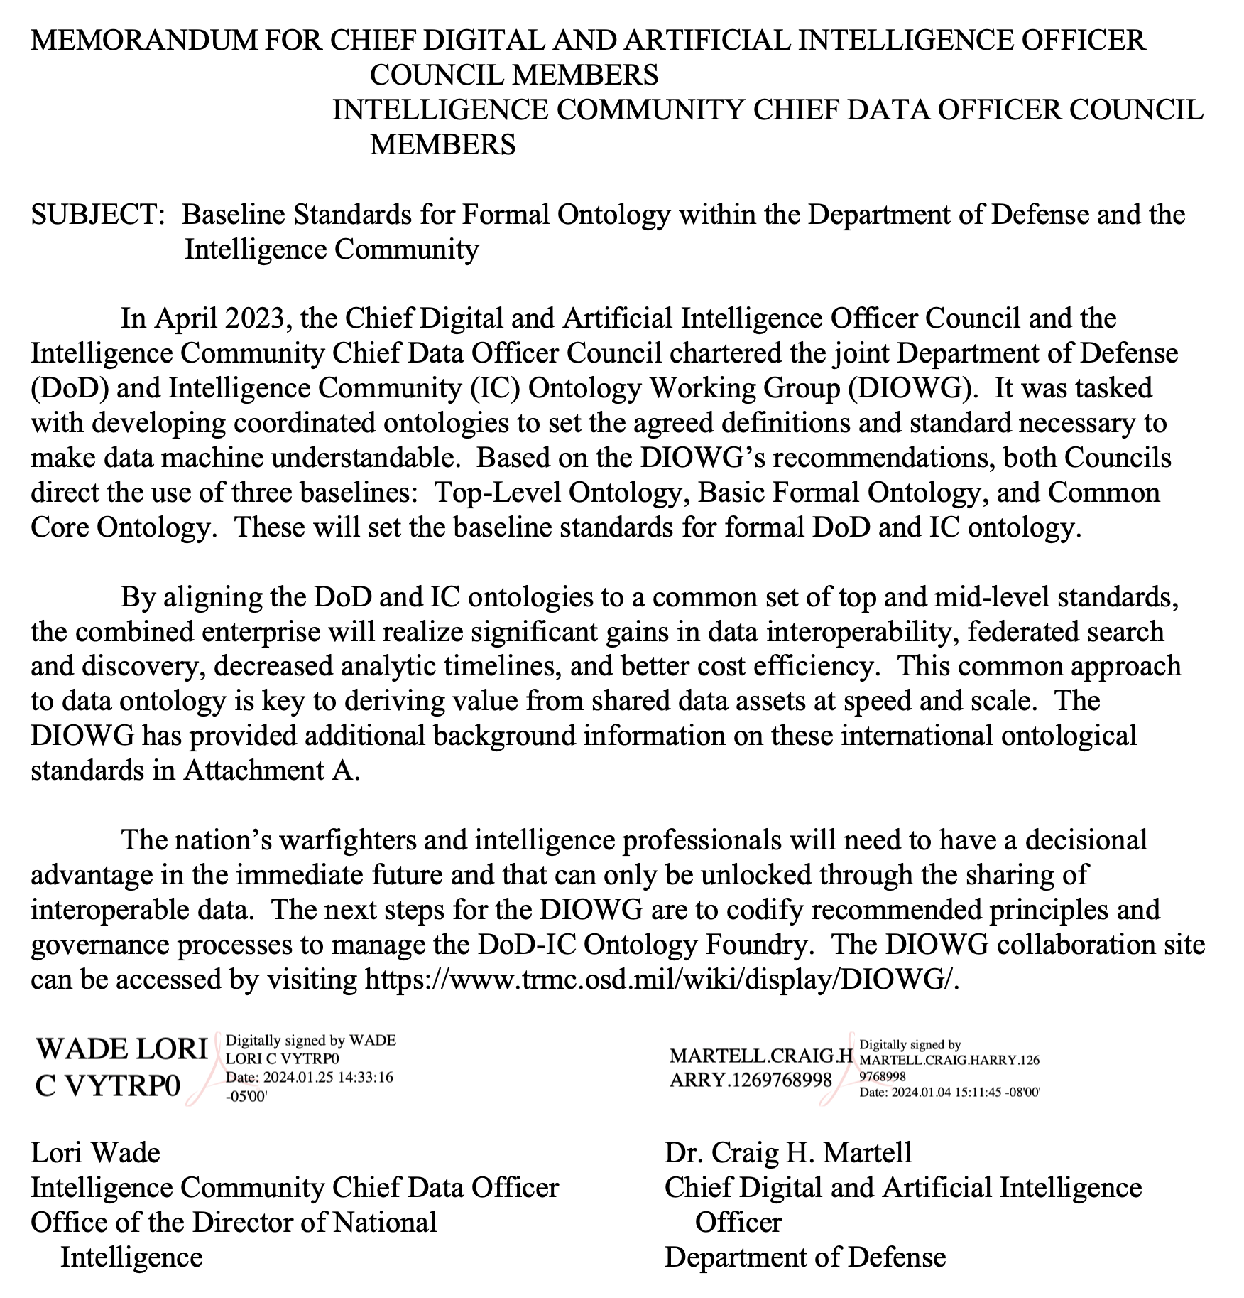
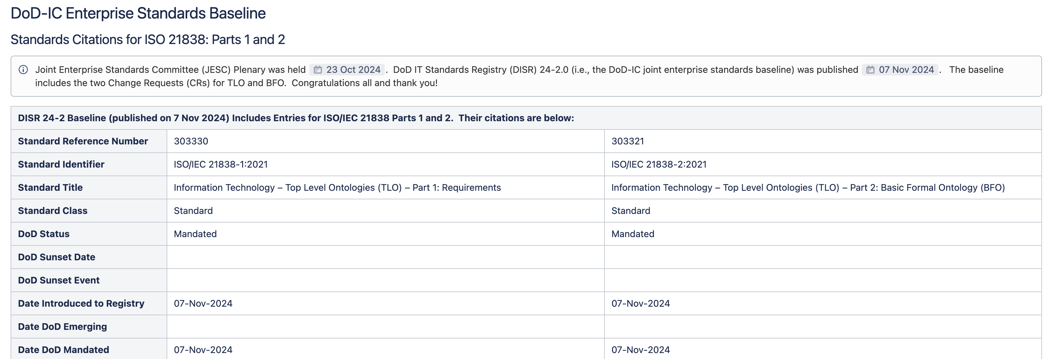


Slide 29
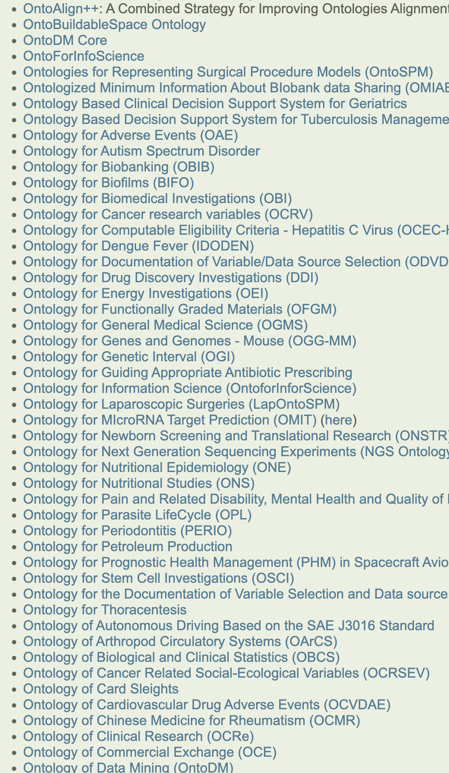
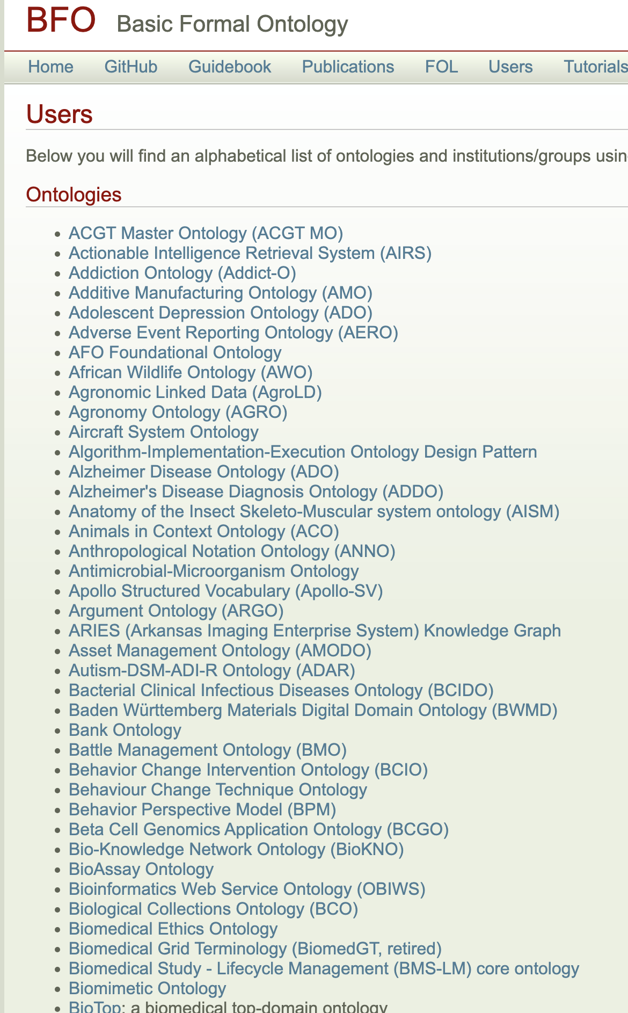
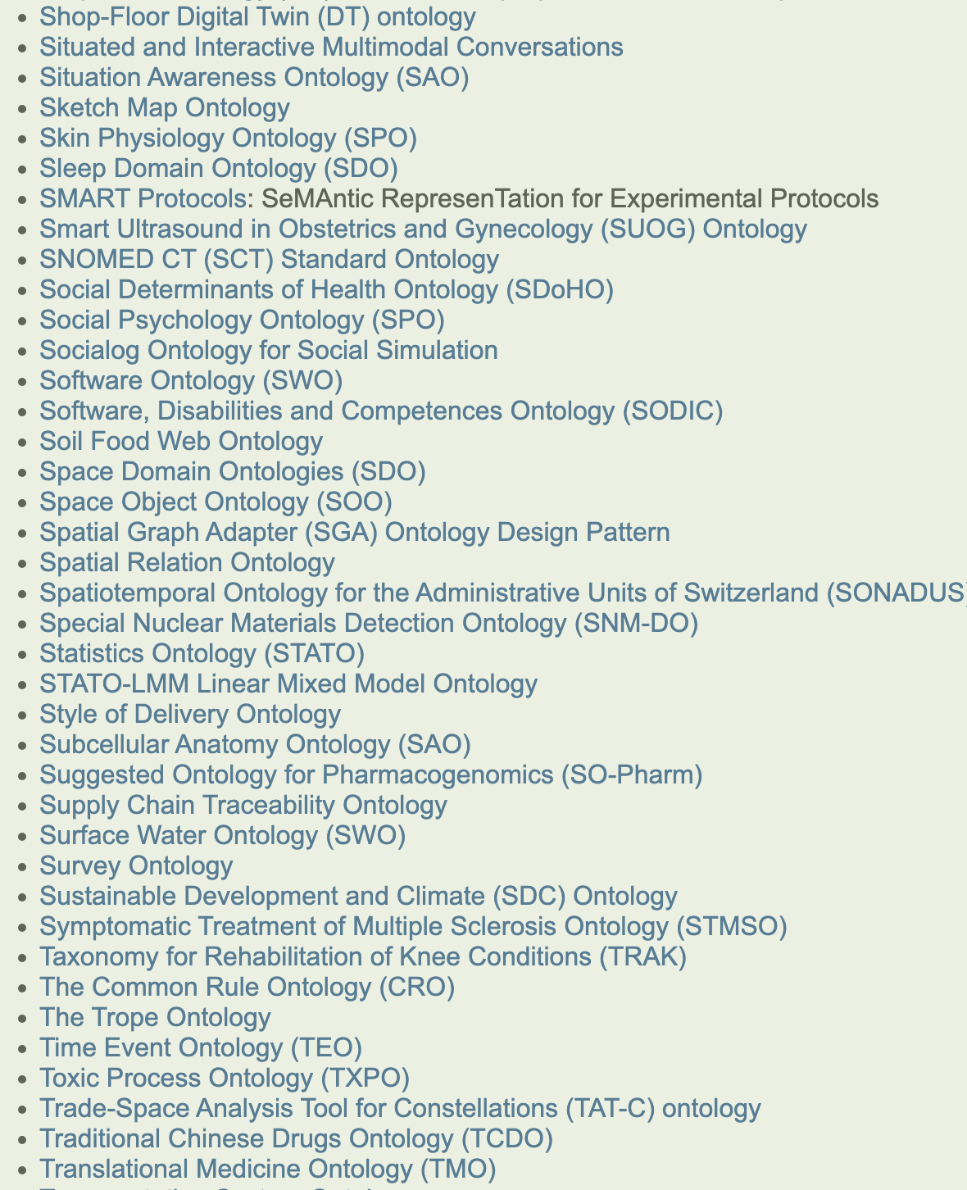
BFO Ecosystem
700+ Projects

Slide 30
Methodological Convictions
Realism – BFO is designed to represent the world, rather than simply concepts about the world
Hub & Spoke – BFO is a hub from which spoke ontologies extend
Fallibilism – BFO is committed to tracking scientific research over time, which might change
Adequatism – BFO is non-reductive, classes and relations motivated by research communities are not ‘paraphrased away’ for example

Slide 31
Methodological Convictions
Realism – BFO is designed to represent the world, rather than simply concepts about the world
Hub & Spoke – BFO is a hub from which spoke ontologies extend
Fallibilism – BFO is committed to tracking scientific research over time, which might change
Adequatism – BFO is non-reductive, classes and relations motivated by research communities are not ‘paraphrased away’ for example

Slide 32
Realism
Ontologies are a specification of fundamental structure of the world
Which encompasses both conceptualism and pragmatism
You will find realism underwriting not just ontologies but logical models, formal specifications, mathematics, etc.

Slide 33

Realism
If we attempt to go from the words we use to the world, it is unlikely that we will end up in the same place
If we attempt to go from the world to the words we use, it is more likely we will remain coordinated

Slide 34
Methodological Convictions
Realism – BFO is designed to represent the world, rather than simply concepts about the world
Hub & Spoke – BFO is a hub from which spoke ontologies extend
Fallibilism – BFO is committed to tracking scientific research over time, which might change
Adequatism – BFO is non-reductive, classes and relations motivated by research communities are not ‘paraphrased away’ for example

Slide 35
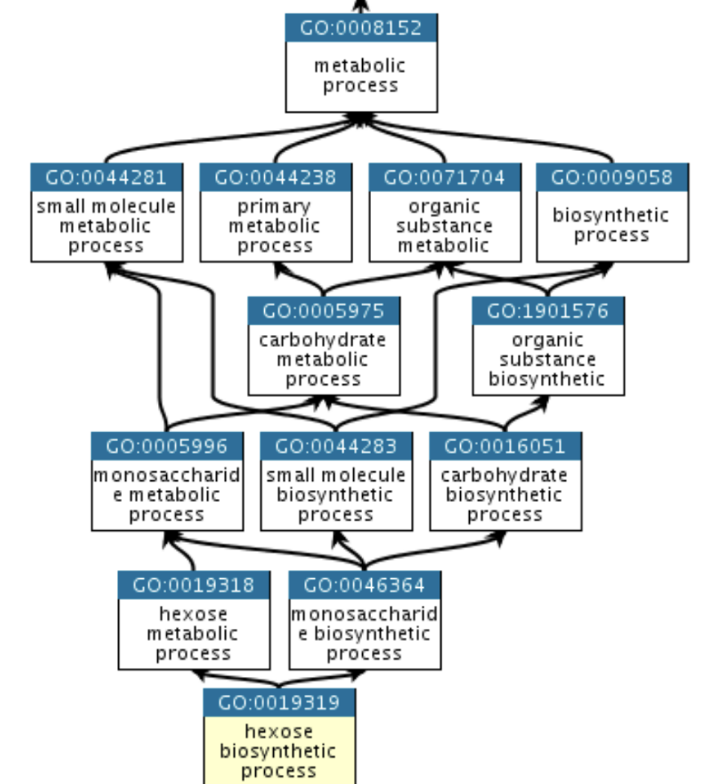

Gene Ontology - 1998
The mission of the GO Consortium is to develop a comprehensive, computational model of biological systems, ranging from the molecular to the organism level, across the multiplicity of species in the tree of life.

Slide 36
Proliferation of Ontologies
When developed correctly, ontologies provide common vocabularies with common semantics across multiple domains
The success of the Gene Ontology led to a proliferation of ontologies developed by subject-matter experts, computer scientists, and logicians

Slide 37
Proliferation of Ontologies
When developed correctly, ontologies provide common vocabularies with common semantics across multiple domains
The success of the Gene Ontology led to a proliferation of ontologies developed by subject-matter experts, computer scientists, and logicians
Almost none of which were developed in coordination
The result was massive incompatibility of terms and relations, confusion, in-fighting, name-calling, etc.

Slide 38
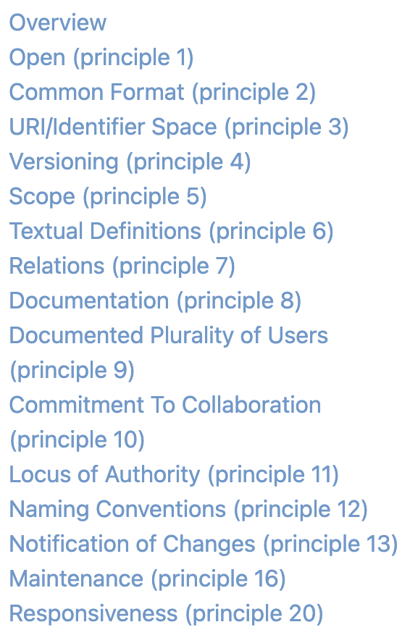
Open Biological and Biomedical Ontologies
In 2005, a consortium of biologists decided to create standards for ontology development
Such as requiring ontologies be open-source, have documentation, include definitions for vocabulary terms and...
Align to a top-level ontology which provides a starting point for all ontology development...

Slide 39
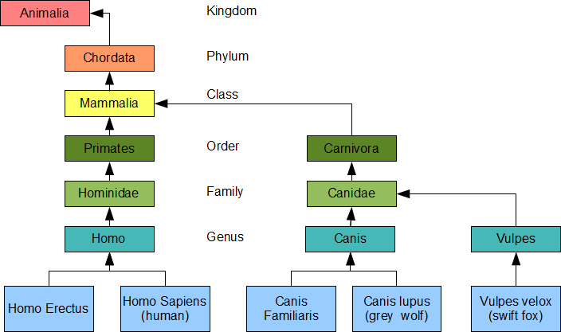

Notes:
https://scs.senecac.on.ca/~oop244/pages/content/inher.html

Slide 40
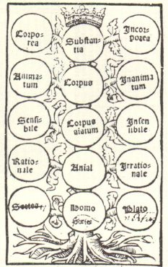
Notes:
https://scs.senecac.on.ca/~oop244/pages/content/inher.html

Slide 41
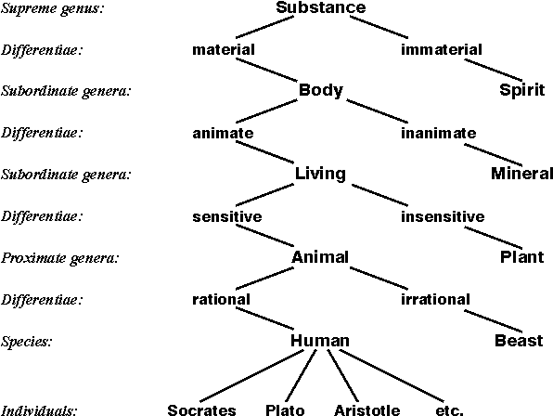
Notes:
https://scs.senecac.on.ca/~oop244/pages/content/inher.html

Slide 42
Notes:
https://scs.senecac.on.ca/~oop244/pages/content/inher.html

Slide 43
Basic Formal Ontology
BFO is such a standard, used by over 700 open-source groups, the first ISO/IEC top-level ontology standard, and a “baseline standard” for DOD-IC ontology development

Slide 44
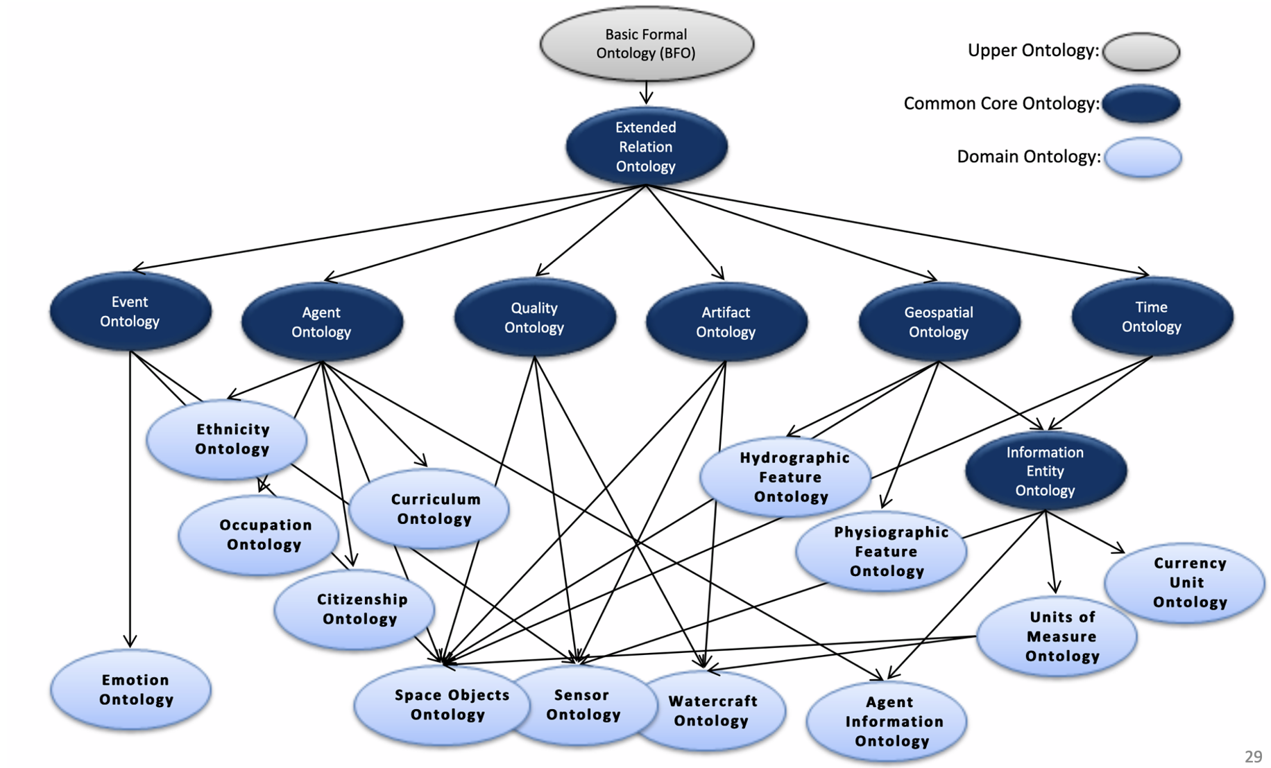

Python Analogy
BFO is analogous to the Python programming language; extensions of BFO are analogous to Python libraries
You could create code that allows you to interact with, say, dataframes or you could instead start with Python and import a library like Pandas
You could create ontology elements that allow you to model artifacts and processes or you could instead start with BFO and import an extension

Slide 45
Hub & Spoke
Ontologies extending from BFO are modules in a larger hub & spoke structure
Ontologies are extended by downward population, new classes have parent classes in a hierarchy ultimately leading to a BFO class

Slide 47
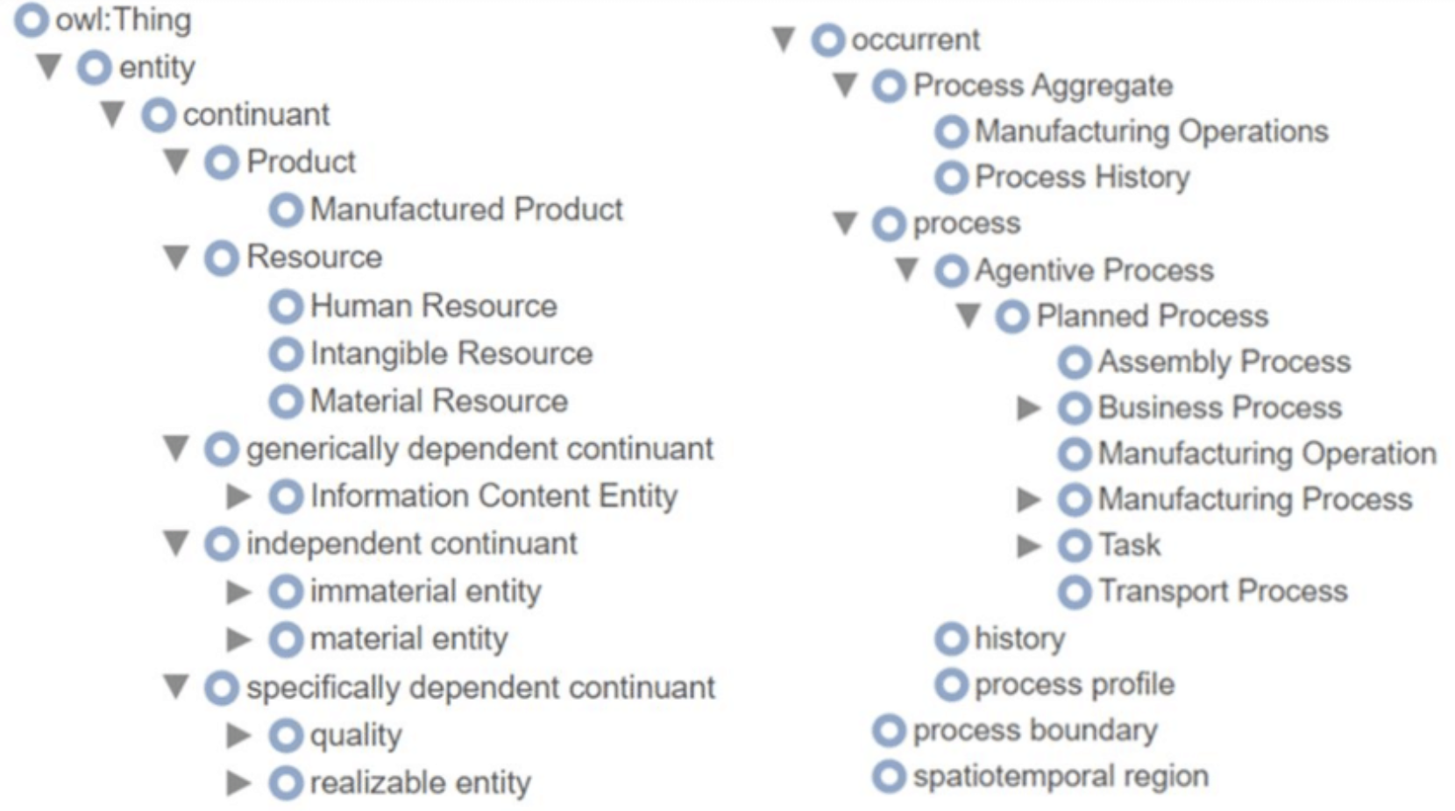

Slide 48
Industrial Ontologies Foundry
IOF is an international standards group that operates under the auspices of the Open Applications Group (OAGi)
Mission:
Create a suite of public and reusable reference ontologies covering the manufacturing domain
Promote the use of ontologies in industrial applications
Work with Government, Industry, Academic and Standards organizations to advance data interoperability in their respective fields

Slide 49
(Incomplete) History of IOF
Initiated in 2016 by:
Barry Smith (University of Buffalo, New York, U.S.)
Hedi Karray (ENIT, Tarbes, France)
Dimitris Kiritsis (EPFL, Switzerland)
Serm Kulvatunyou (NIST, Maryland, U.S.)
Modeled after the Open Biological and Biomedical Ontology Foundry (OBO)
Became a legal entity under OAGi in 2021

Slide 50

















50+ Organizations
50

Slide 51

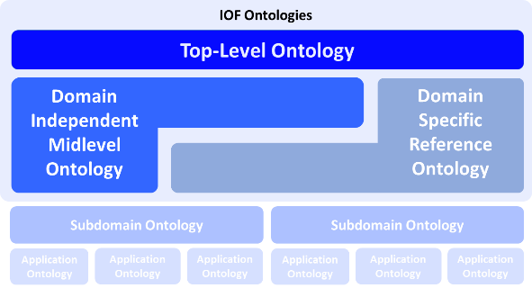
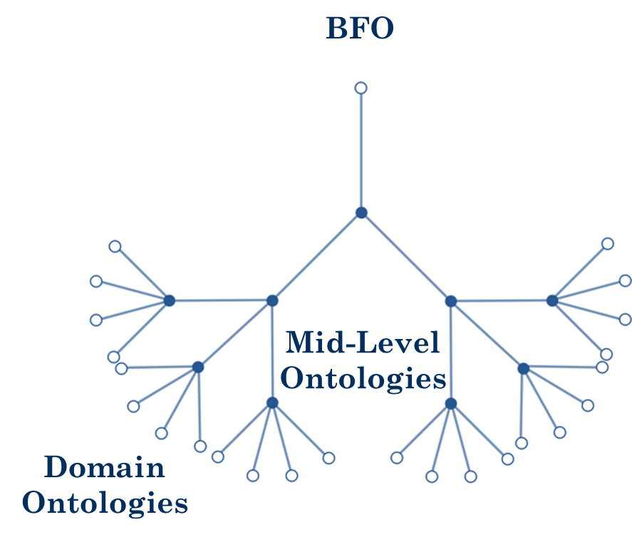
(BFO)
Supply chain
Maintenance
Production planning & scheduling
Engineering Design
Service
Systems Engineering
Hub-and-Spoke Architecture

Slide 52
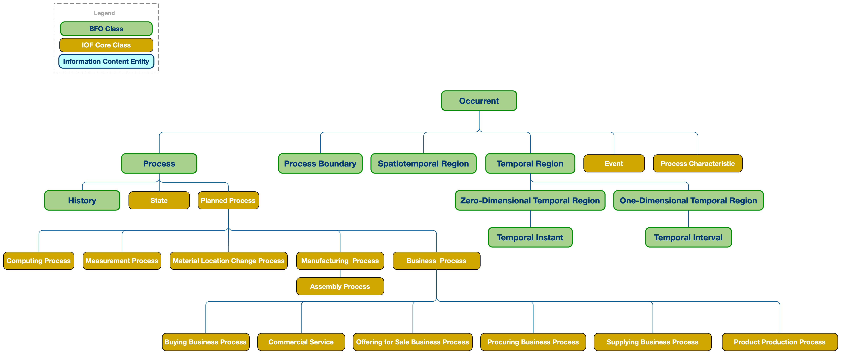
IOF Core: Entities Existing Over Time

Slide 53
IOF Core: Entities with Material Parts

Slide 54
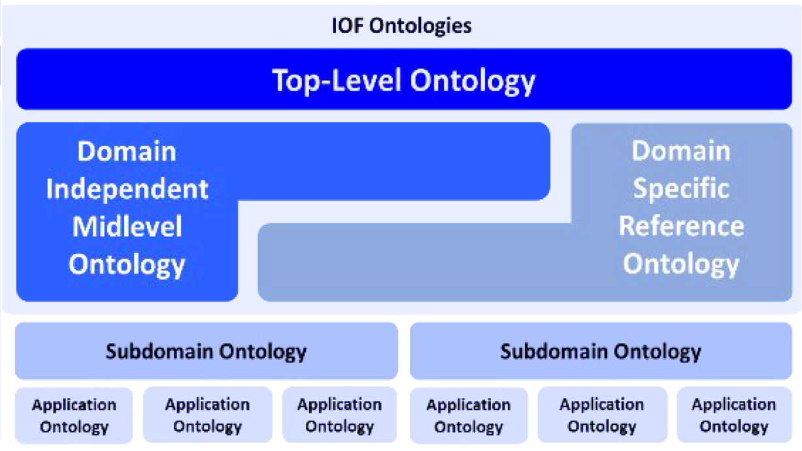
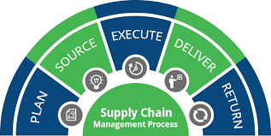
Supply Chain Core Ontology (SCRO)
Objective:
Identify the requirements of reference ontologies (RO) in the supply chain domain,
Develop SCRO and other lower-level ontologies in SC domain
Scope:

Slide 55
Scope
logistics and transportation, organizations, supply and service chains, facilities, traceability, inventory management

Slide 56
SCRO: Supply Chain Roles

Slide 57
SCRO: Business Processes

Slide 58
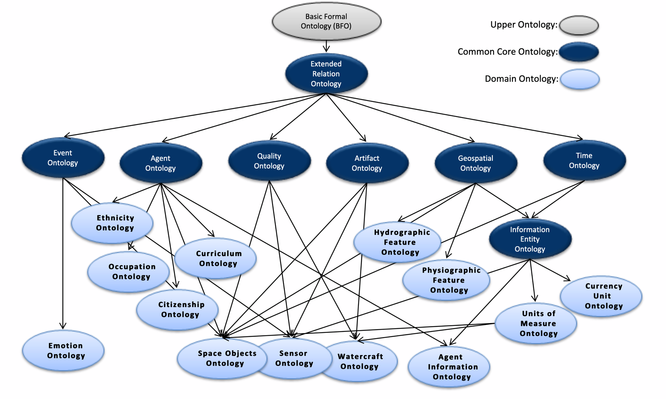

Slide 59

Hub-and-Spoke

Slide 60
Methodological Convictions
Realism – BFO is designed to represent the world, rather than simply concepts about the world
Hub & Spoke – BFO is a hub from which spoke ontologies extend
Fallibilism – BFO is committed to tracking scientific research over time, which might change
Adequatism – BFO is non-reductive, classes and relations motivated by research communities are not ‘paraphrased away’ for example

Slide 61
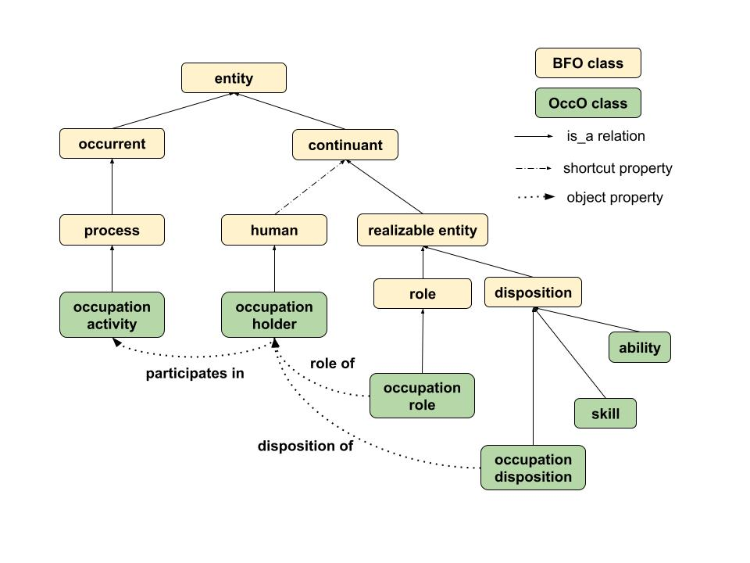
The Occupation Ontology

Slide 62
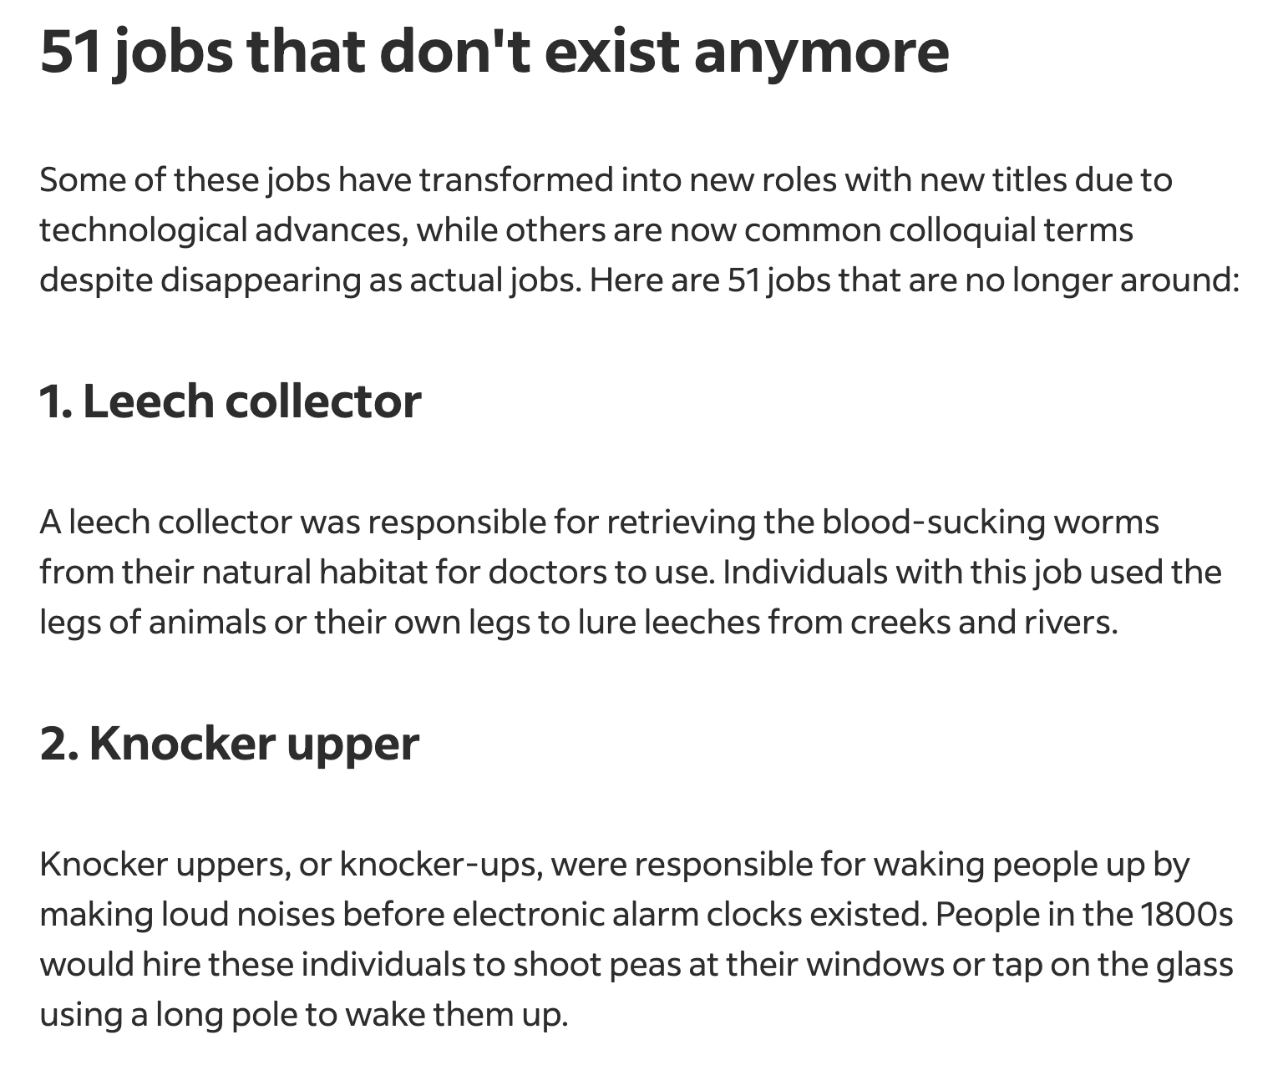

Slide 63


Slide 64


Slide 65
Methodological Convictions
Realism – BFO is designed to represent the world, rather than simply concepts about the world
Hub & Spoke – BFO is a hub from which spoke ontologies extend
Fallibilism – BFO is committed to tracking scientific research over time, which might change
Adequatism – BFO is non-reductive, classes and relations motivated by research communities are not ‘paraphrased away’ for example

Slide 66
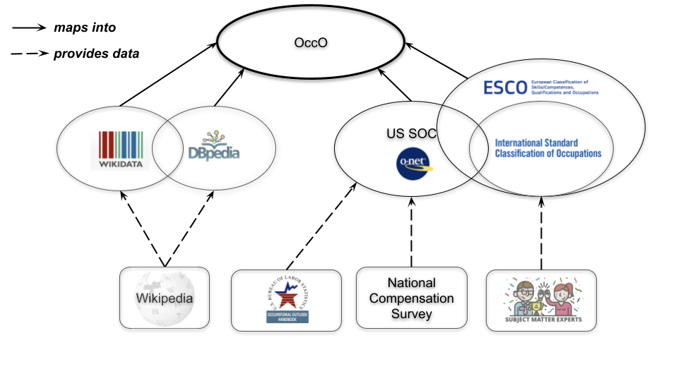

Slide 67
Adequatism
Does US SOC cover everything within its intended scope? Likely not.
A common semantic layer connecting standards reflecting occupation-related information allows for cross-validation, identification of gaps in coverage, overlooked synonymous labels and descriptions, etc.

Slide 68
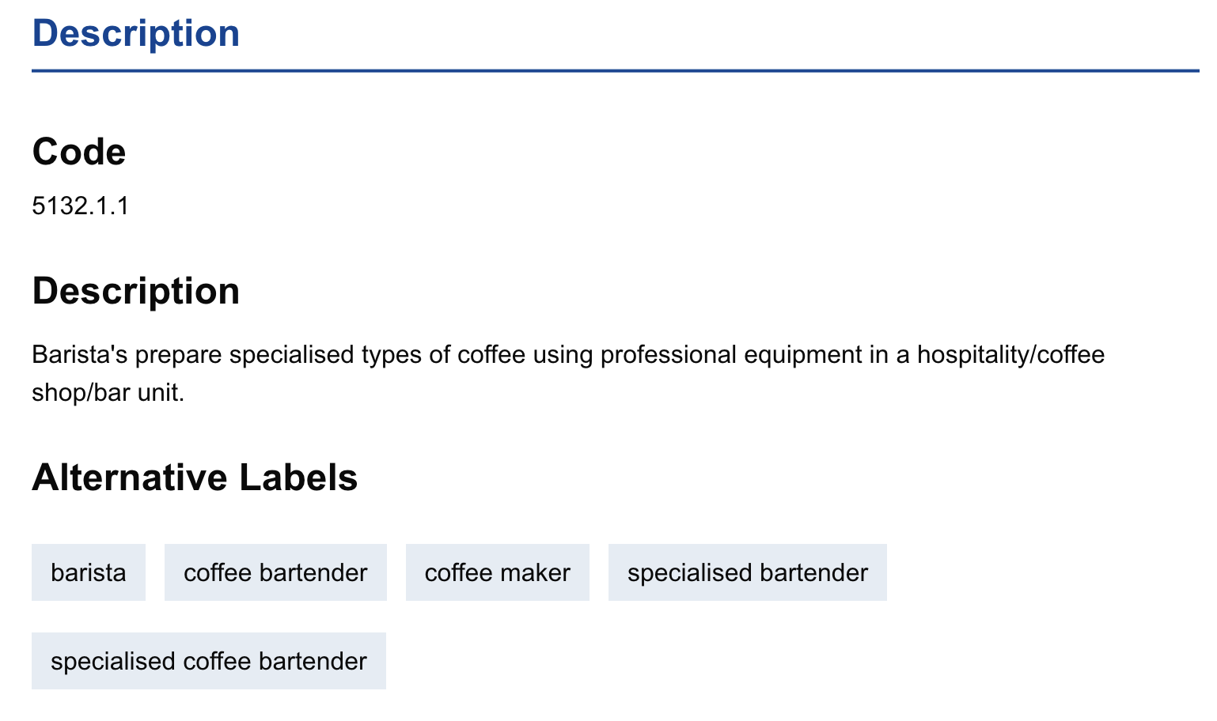
ESCO
Subject-matter experts - among other sources –
inform the development of ISCO and ESCO
standards

Slide 69
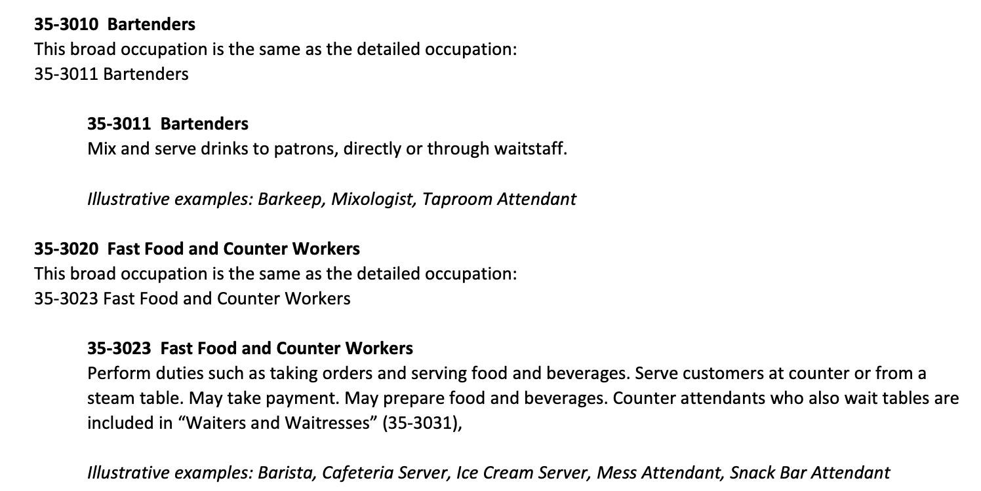
US SOC
The National Compensation Survey
and Occupation Outlook Handbook inform the development of
US SOC/O*NET

Slide 70
METHODOLOGICAL DETOUR

Slide 71
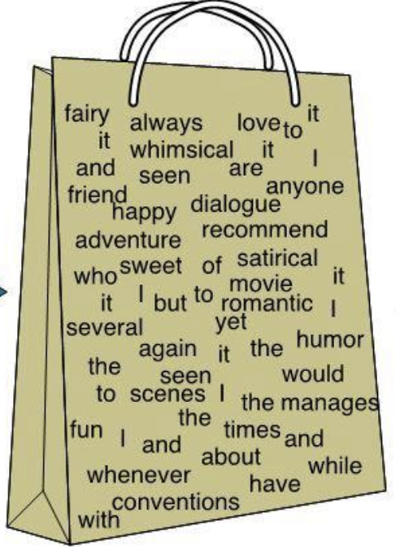
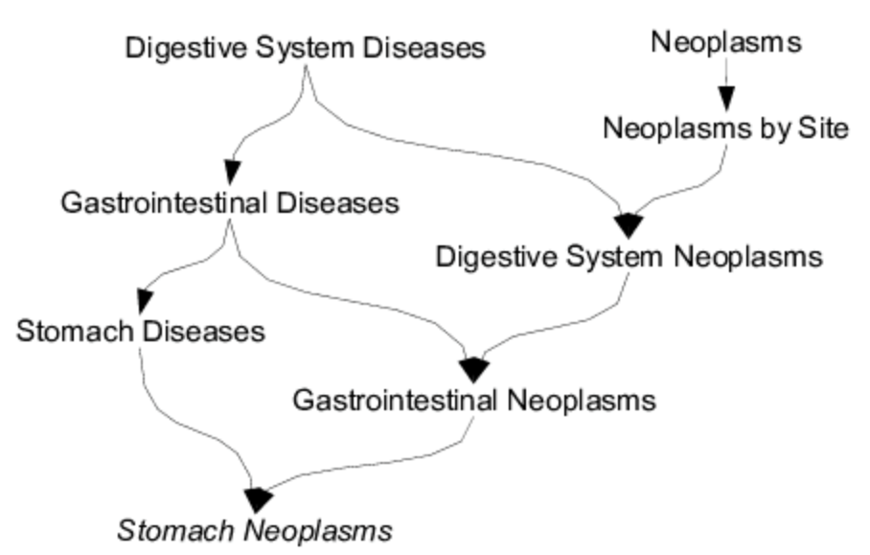
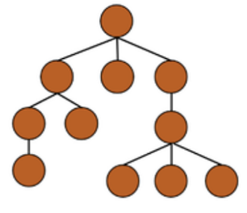
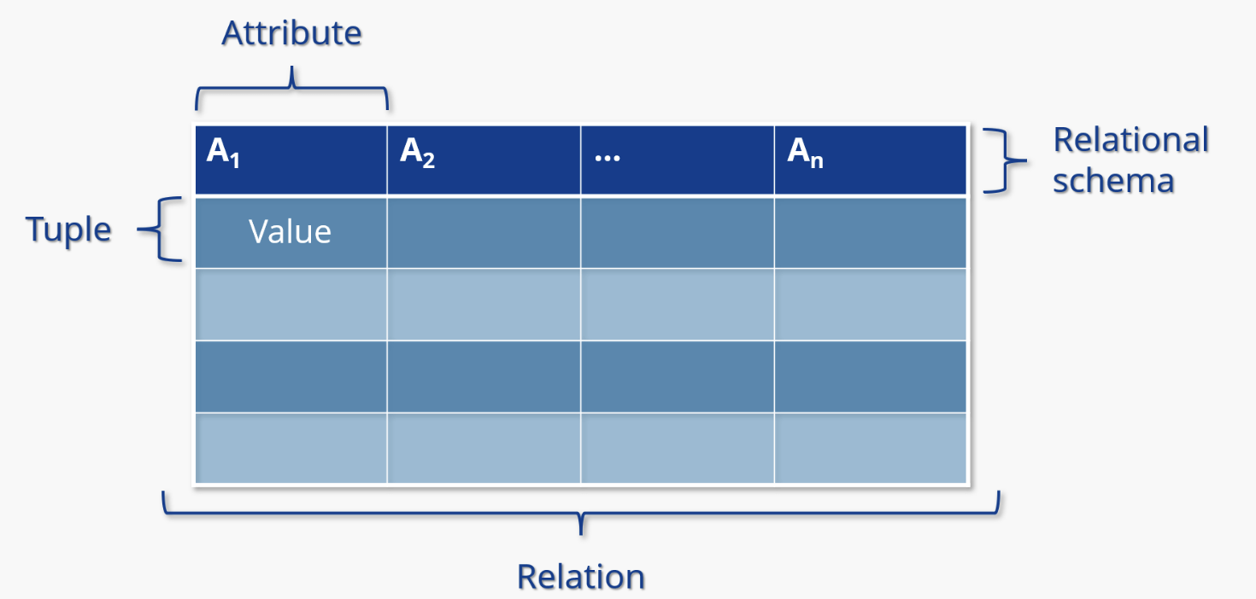
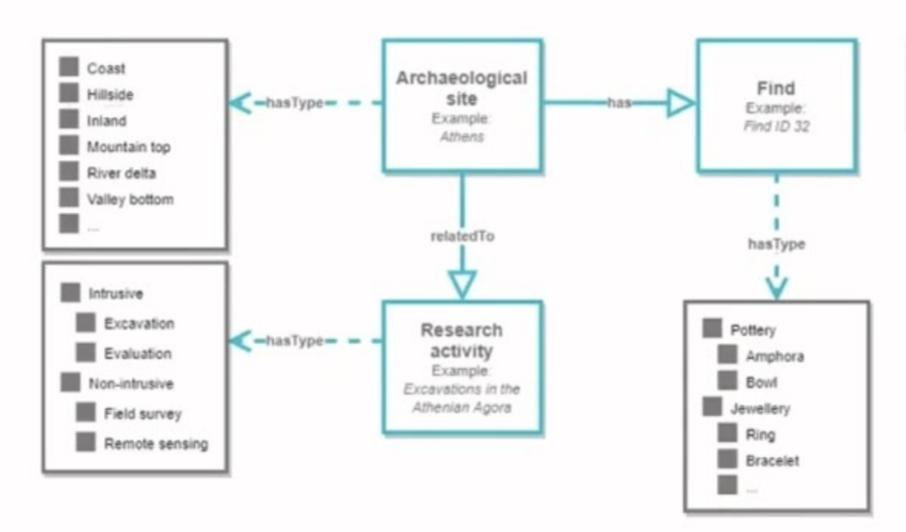
Bag of
Words
Thesaurus
BFO
Ontology
Relational Database
Controlled Vocabulary

Slide 72
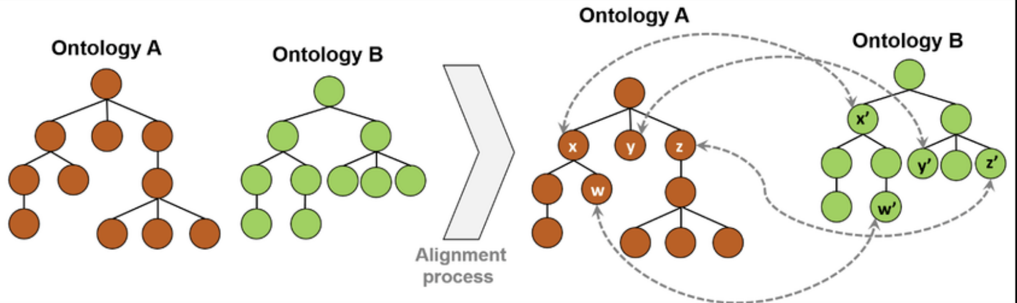
Caveat: Mono-Ontology Myth
Insisting on a single ontology standard used by everyone is unwise
The point is, rather, that progress towards interoperability can be made by leveraging suites of ontologies with common semantics which adopt wise design principles of the sort exhibited in the BFO community

Slide 73
The choice of top-level does not matter as much as you might think

Slide 74
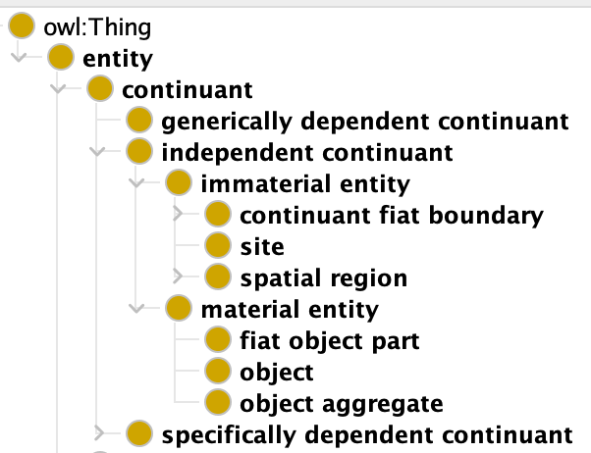

Generating Implicit Hierarchy
Suppose there is a need to maintain
an application ontology that is not aligned to BFO

Slide 75

Generating Implicit Hierarchy

Slide 76
Generating Implicit Hierarchy

Slide 77
Generating Implicit Hierarchy

Slide 78
Generating Implicit Hierarchy

Slide 79
military taxonomy relation
One way forward is to introduce an object property – call it military taxonomy – that connects instances of the reference ontology to those of the military artifact class
To simulate the subclass of relation, we assert that military taxonomy is reflexive and transitive
And is such that any entity in the domain can be related only to instances under military artifact

Slide 80

Reflexivity
For all x, x is related to x
{(x,x) | x ∈ Domain} ⊆ R^{I}
THING

Slide 81
Transitivity
If x related to y and y related to z, then x related to z
Trans(R) = R^{I} ◦ R^{I} ⊆ R^{I}
THING

Slide 82
Transitivity
If x related to y and y related to z, then x related to z
Trans(R) = R^{I} ◦ R^{I} ⊆ R^{I}
THING

Slide 83




Generating Implicit Hierarchy

Slide 84
Generating Implicit Hierarchy

Slide 85


Generating Implicit Hierarchy

Slide 86
Caveat: Disjointness
Disjointness – A and B are disjoint just in case they share no individuals
DisjointWith(A, B) = A^{I} ∩ B^{I} = ∅
THING
A
B

Slide 87
Caveat: Disjointness Must be Dropped
In BFO, the class site and the class object are disjoint, which means they may share no instances in common
Consequently, operation area cannot – strictly speaking – be an asserted subclass of object and inferred subclass of site
Importantly, such constraints should be understood as applying at the level of reference ontologies, not necessarily application ontologies

Slide 88
Real-World Ontology Engineering
Converting across top-level perspectives using reasoning requires deviating slightly from semantic commitments
But most implementations of ontologies do not even leverage the full – albeit limited – semantics of OWL
Those rare cases where the full semantics are needed can be handled on a case by case basis

Slide 89
Real-World Ontology Engineering
Converting across top-level perspectives using reasoning requires deviating slightly from semantic commitments
But most implementations of ontologies do not even leverage the full – albeit limited – semantics of OWL
Those rare cases where the full semantics are needed can be handled on a case by case basis
CONFIGURATION MANAGEMENT

Slide 90
Outline
Module 1: Motivation for Ontology Engineering
Module 2: Motivation for Basic Formal Ontology
Module 3: Theory of BFO
Module 4: Building Ontologies with BFO
Module 5: Exercises

Slide 91
Continuant

Slide 92
Continuant
Continuants exist in time, wholly present whenever they exist at all; they are entities that lack temporal parts
Continuant
object, quality …

Slide 93
Occurrent

Slide 94
Occurrent
Occurrents exist over time, in that they have temporal parts
Continuant
object, quality …
Occurrent
process, event

Slide 95
Parthood
Among the most important logical relationships is parthood
Which in BFO comes in two flavors:
continuant parthood
occurrent parthood
Reflecting that the class Continuant is closed under parthood, and Occurrent is as well

Slide 96
No continuant may have or be part of any occurrent
No occurrent may have or be part of any continuant

Slide 97
Classes represent collections of instances For example: the class of tables falls under the class of objects and your dinner table would be an instance of the former
Class A is_a Class B means any instance of Class A is an instance of Class B

Slide 98
Types and Tokens
Continuant
Occurrent
process, event
Independent
Continuant
object
Dependent
Continuant
quality
... .... ......

Slide 99
Types and Instances
Continuant
Occurrent
process, event
TYPE
Independent
Continuant
object
Dependent
Continuant
quality
... .... ......
INSTANCE

Slide 100
(In)dependence
Continuant
Occurrent
process, event
Independent
Continuant
object
Dependent
Continuant
quality
Some continuants depend for their existence on others
... .... ......

Slide 101
Dependence
For certain entities, their existence depends on the existence of something else
Other entities do not depend on any other entities for their existence
The latter are categorized in BFO as independent continuants
The former include specifically dependent and generically dependent entities, as well as processes

Slide 102
Dependence
For certain entities, their existence depends on the existence of something else
Other entities do not depend on any other entities for their existence
The latter are categorized in BFO as independent continuants
The former include specifically dependent and generically dependent entities, as well as processes

Slide 103
Specifically Dependent Continuant

Slide 104
Specifically Dependent Continuant
These are continuants that in every case specifically depend on some independent contiuant for their existence
For example, the mass of a tomato specifically depends on a given tomato, the shape of your smile depends on your face, and so on

Slide 105
Specifically Dependent Continuant
These are continuants that in every case specifically depend on some independent contiuant for their existence
For example, the mass of a tomato specifically depends on a given tomato, the shape of your smile depends on your face, and so on
Importantly, SDCs cannot migrate across bearers, i.e. the specific shape of your smile depends on you and so cannot specifically depend on me

Slide 106
Quality

Slide 107


Qualities
Continuant
Occurrent
process, event
Independent
Continuant
apple
Quality
redness
Qualities inhere in
independent continuants
......

Slide 108
Quality
In BFO, instances of Quality are said to manifest in full whenever they manifest at all
For example, when an apple bears a redness quality, there is nothing more to that quality than the redness
Similarly, the shape of the smile on your face is there for the world to see whenever it is there at all; there is nothing more to the shape than what is presented on your face

Slide 109
Subclasses of Quality
That said, your various qualities and mine may be instances of the same subclass of the class Quality
Quality
Weight

Slide 110
Subclasses of Quality
That said, your various qualities and mine may be instances of the same subclass of the class Quality
14 KG
Quality
Weight
15 KG
16 KG

Slide 111



Subclasses of Quality
That said, your various qualities and mine may be instances of the same subclass of the class Quality
TYPE
INSTANCE
14 KG
. . .
Quality
Weight
15 KG
16 KG

Slide 112
Determinates and Determinibles
Certain instances of Quality may fall under different specializations of subclasses of Quality
14 KG
. . .
Quality
Weight
15 KG
16 KG

Slide 113
Determinates and Determinibles
Certain instances of Quality may fall under different specializations of subclasses of Quality
14 KG
.
Quality
Weight
15 KG
16 KG

Slide 114
Determinates and Determinibles
Certain instances of Quality may fall under different specializations of subclasses of Quality
14 KG
.
Quality
Weight
15 KG
16 KG

Slide 115
Determinates and Determinibles
We call the subclasses of Quality that remain the same throughout determinibles and those specializations that change determinates
DETERMINIBLE
14 KG
.
Quality
Weight
15 KG
16 KG
DETERMINATE

Slide 116
Determinates and Determinibles
Even with determinate change, however, at no point does an instance of Quality migrate to a new bearer; rather, there are distinct instances
DETERMINIBLE
14 KG
.
Quality
Weight
15 KG
16 KG
DETERMINATE

Slide 117
Determinates and Determinibles
Traditionally, determinates exhibit some ordering relative to a given determinible
If P is a determinate of determible Q, then:
P is more specific than Q
There is a strict partial ordering of determination between P and Q
Neither P nor Q can causally exclude one another
Any two detereminates P₁ and P₂ of Q are comparable
Caveat: The preceding is not official BFO, but from observation

Slide 118
Realizable Entity

Slide 119


Realizable Entity
Continuant
Occurrent
process, event
Independent
Continuant
NaCl
Realizable Entity
solubility
Not all dependent entities
fully manifest when they exist
......

Slide 120
Realizable Entity
Attributes of some material bearer that only become manifest under certain conditions
Put another way, realizable entities underwrite what bearers can do

Slide 121
Rule of Thumb
There is a portion of sodium chloride before you
Suppose I ask “Does this portion exhibit a lattice structure?”
You need only look at the salt to find an answer
Suppose I ask “Is this portion soluble in unsaturated H₂O?”
You cannot simply look at the salt to find an answer

Slide 122
Modality
Realizable Entities are how BFO represents modality
The way the world is often differs from the way the world could be, could have been, and will be
A yoga mat is black and you can see this; it could support a sleeping cat without you seeing it

Slide 123
Disposition

Slide 124
Disposition
Attributes of some material bearer that only become manifest under certain conditions
Disposition
A realizable entity such that if it ceases to exist, then its bearer is physically changed, and its realization occurs when and because this bearer is in some special physical circumstances, and this realization occurs in virtue of the bearer's physical make-up

Slide 125


Slide 126
Disposition
Attributes of some material bearer that only become manifest under certain conditions
Disposition
A realizable entity such that if it ceases to exist, then its bearer is physically changed, and its realization occurs when and because this bearer is in some special physical circumstances, and this realization occurs in virtue of the bearer's physical make-up
INTERNALLY GROUNDED

Slide 127
Role

Slide 128
Role
Attributes of some material bearer that only become manifest under certain conditions
Role
A realizable entity that exists because there is some single bearer that is in some special physical, social, or institutional set of circumstances in which this bearer does not have to be, and is not such that, if it ceases to exist, then the physical make-up of the bearer is thereby changed.

Slide 129


Slide 130
Role
Attributes of some material bearer that only become manifest under certain conditions
Role
A realizable entity that exists because there is some single bearer that is in some special physical, social, or institutional set of circumstances in which this bearer does not have to be, and is not such that, if it ceases to exist, then the physical make-up of the bearer is thereby changed.
EXTERNALLY GROUNDED

Slide 131

Barry Smith instance_of Agent
Material Entity
Object
CLASSES
Agent
INSTANCES

Slide 132

SUNY Professor instance_of Professor Role
Material Entity
Realizable Entity
Object
Role
CLASSES
Agent
Professor Role
INSTANCES

Slide 133
Barry Smith bearer_of SUNY Professor
Material Entity
Realizable Entity
Object
Role
CLASSES
Agent
Professor Role
INSTANCES

Slide 134
Function

Slide 135
Function
Attributes of some material bearer that only become manifest under certain conditions
Function
A disposition that exists in virtue of the bearer's physical make-up and this physical make-up is something the bearer possesses because it came into being, either through evolution (in the case of natural biological entities) or through intentional design (in the case of artefacts), in order to realize processes of a certain sort.

Slide 136



Slide 137
Function
Attributes of some material bearer that only become manifest under certain conditions
Function
A disposition that exists in virtue of the bearer's physical make-up and this physical make-up is something the bearer possesses because it came into being, either through evolution (in the case of natural biological entities) or through intentional design (in the case of artefacts), in order to realize processes of a certain sort.
PURPOSE GROUNDED

Slide 138
Dependence
For certain entities, their existence depends on the existence of something else
Other entities do not depend on any other entities for their existence
The latter are categorized in BFO as independent continuants
The former include specifically dependent and generically dependent entities, as well as processes

Slide 139
Generically Dependent Continuant

Slide 140

Pattern Recognition
We’re disposed to recognize patterns with our perceptual faculties…

Slide 141


Pattern Recognition
We’re disposed to recognize patterns with our perceptual faculties…
…and with our cognitive faculties…
Photo 51 crystallography image by Rosalind
Double-helix hypothesized by Watson and Crick

Slide 142
BFO 1.0
Earlier versions of BFO did not permit dependent entities to migrate from bearer to bearer
This is true in current versions of BFO for many cases, e.g. your smile is dependent on your face
As mentioned, dependent continuants that cannot migrate fall under the class Specifically Dependent Continuant

Slide 143
Patterns
A need arose to represent dependent entities that could migrate across bearers
This need led to generically dependent continuants, continuants that are in some sense copyable, i.e. patterns
For example, “Snow is white” and “Schnee ist weiß” may be used to express numerically identical content, i.e. the same pattern

Slide 144
Real Patterns
Some patterns are necessarily about something; some patterns are not
“Snow is white” expresses content that is about snow
“cm” or “.” are not necessarily about anything; they are nevertheless patterns
Most generically dependent entities represented in BFO extensions are patterns that are about something

Slide 145
Aboutness
Information is a pattern that is about something
In BFO extensions - such as the Information Artifact Ontology and the Information Entity Ontology - information is represented by the class Information Content Entity
Where the “is about” relation is understood to be primitive:

Slide 146

Generically Dependent Continuant
Continuant
Occurrent
process, event
Independent
Continuant
apple
GD
Continuant
temp measure
Many measures are about
independent continuants
......

Slide 147

CCO Measurement

Slide 148
CCO Measurement
An object has some quality of
interest, such as length

Slide 149
CCO Measurement
...which is measured by some information content entity...

Slide 150
CCO Measurement
...inhering in a bearer...

Slide 151
CCO Measurement
...with an associated measurement unit...

Slide 152
CCO Measurement
...and value.

Slide 153
CCO Measurement
“is measured by”
is the inverse of
“is measurement of”

Slide 154
CCO Measurement
“is measurement of”
is a subproperty of
“is about”

Slide 155

Generically Dependent Continuant
Continuant
Occurrent
process, event
GD
Continuant
orchestra plan
GD
Continuant
symphony
GDCs may be about other GDCs
......
Beethoven’s #9

Slide 156

#9 Concretized in Ink Inscription
Information Content
Entity
Specifically Dependent
Continuant
CLASSES
Musical Work
Information
Quality Entity
Ink
Inscription
Symphony
INSTANCES
Beethoven’s #9

Slide 157
Ink Inscription inheres in Parchment
Specifically Dependent
Continuant
Material Entity
CLASSES
Information
Quality Entity
Information
Bearing Entity
Parchment
Ink
Inscription
INSTANCES

Slide 158
#9 Generically Dependent On Parchment
Information Content
Entity
Material Entity
CLASSES
Musical Work
Information
Bearing Entity
Parchment
Symphony
INSTANCES
Beethoven’s #9

Slide 159
#9 is about Orchestra Plan
Information Content
Entity
Information Content
Entity
CLASSES
Musical Work
Plan Specification
Orchestra Plan
Symphony
INSTANCES
Beethoven’s #9

Slide 160

Musician Plan realized in #9 Performance
Disposition
Process
CLASSES
Plan
Planned Process
Musician Plan
#9 Performance
INSTANCES

Slide 161
Beethoven’s #9th Symphony
Beethoven’s #9
is about
generically depends on
concretized
in
concretized in
inheres in
has realization

Slide 162
Material Entity

Slide 163
Material Entity
Many independent continuants discussed thus far depend on instances falling under the class Material Entity, which includes all independent continuants having matter as part
Apples, people, cars, blankets, viruses, tanks, etc. thus fall
Subclasses include objects, object aggregates, and fiat object parts

Slide 164
Subclasses of Material Entity

Slide 165
Object
An object is a material entity that manifests causal unity, where its instances are maximal with respect to that causal unity

Slide 166
Object
An object is a material entity that manifests causal unity, where its instances are maximal with respect to that causal unity

Slide 167

Object
An object is a material entity that manifests causal unity, where its instances are maximal with respect to that causal unity
Examples of causal unity:
Physical covering, e.g. interior of the object are covered by a connected membrane

Slide 168

Object
An object is a material entity that manifests causal unity, where its instances are maximal with respect to that causal unity
Examples of causal unity:
Physical covering, e.g. interior of the object are covered by a connected membrane
Internal forces, e.g. ionic bonds holding together molecules

Slide 169

Object
An object is a material entity that manifests causal unity, where its instances are maximal with respect to that causal unity
Examples of causal unity:
Physical covering, e.g. interior of the object are covered by a connected membrane
Internal forces, e.g. ionic bonds holding together molecules
Engineered assembly, e.g. mechanical assembly through screws or fasteners

Slide 170
Rule of Thumb
If moving a proper part of some material entity requires moving other material parts of that entity, there is likely causal unity between them

Slide 171
Object
An object is a material entity that manifests causal unity, where its instances are maximal with respect to that causal unity

Slide 172
Object
An object is a material entity that manifests causal unity, where its instances are maximal with respect to that causal unity
To say x is maximal with respect to causal unity is to say x is:
causally unified by that causal unity

Slide 173
Object
An object is a material entity that manifests causal unity, where its instances are maximal with respect to that causal unity
To say x is maximal with respect to causal unity is to say x is:
causally unified by that causal unity
if x is part of some y and y is causally unified in precisely the same way, then x is identical to y

Slide 174
Object
An object is a material entity that manifests causal unity, where its instances are maximal with respect to that causal unity
To say x is maximal with respect to causal unity is to say x is:
causally unified by that causal unity
if x is part of some y and y is causally unified in precisely the same way, then x is identical to y
For example, relative to causal unity by covering, your torso is not maximal, but the whole of you as an organism is maximal

Slide 175
Object Aggregate
Defined such that any and all members of the aggregate are objects which do not share any parts in common, i.e. are pairwise disjoint
For example, one can define the object aggregate that is all instruments in an orchestra, or all members of a band
More generally, the “X aggregate” is intended to be a recipe that may be applied to other classes, e.g. “aggregate of roles”

Slide 176
Fiat Object Part
Certain parts of objects that are not themselves objects, warrant catergorization beyond merely being identified as parts
For example, a so-called bona fide object part of the Earth, which would be an object, such as an island, may be divided into northern and southern fiat object parts
Northern and southern portions of a given island exist regardless of whether we delineate them so

Slide 177
Immaterial Entity

Slide 178
Any entity that has a material entity as part is a material entity
But material entities may have immaterial entities as parts

Slide 179
Immaterial Entity
Not all independent continuants have matter as parts
Territorial boundaries, internal hulls of ships, interiors of capsules, etc. are not identical to whatever material is often associated with them
For example, an archaeologist seeking the site through which a contemporary river used to flow, is not looking for the material the river used to flow through, for that is lost to time

Slide 180
Continuant Fiat Boundary
Continuant Fiat Boundary =_{def} An immaterial entity such that there is no time t when it has a spatial region as continuant part & whose location is determined in relation to some material entity

Slide 181
Continuant Fiat Boundary
Continuant Fiat Boundary =_{def} An immaterial entity such that there is no time t when it has a spatial region as continuant part & whose location is determined in relation to some material entity
In BFO, objects are three-dimensional and have two-dimensional boundaries, e.g. surfaces
There are no three-dimensional boundaries, because boundaries are always entities of some lower dimension

Slide 182
Dimension Constraint
x has a lower dimension than y
irreflexive
asymmetric
transitive

Slide 183
Dimension Constraint
x has a lower dimension than y
irreflexive
asymmetric
transitive
If x is boundary of y then x has lower dimension than y

Slide 184
Site

Slide 185
Site
Site =_{def} A three-dimensional immaterial entity whose boundaries either (partially or wholly) coincide with the boundaries of one or more material entities or have locations determined in relation to some material entity

Slide 186

Site
Site =_{def} A three-dimensional immaterial entity whose boundaries either (partially or wholly) coincide with the boundaries of one or more material entities or have locations determined in relation to some material entity
Examples:
A rabbit hole
The interior of your bedroom
The hold of a ship
The cockpit of an aircraft

Slide 187
Spatial Region

Slide 188
Spatial Regions
Spatial Region =_{def} A continuant that is continuant part of the spatial projection of a portion of spacetime at a given time

Slide 189
Spatial Regions
Spatial Region =_{def} A continuant that is continuant part of the spatial projection of a portion of spacetime at a given time
spatially projects onto =_{def} Holds between spatiotemporal region s and spatial region r at some time t such that r is the spatial extent of s at t

Slide 190
Spatial Regions
Spatial Region =_{def} A continuant that is continuant part of the spatial projection of a portion of spacetime at a given time
spatially projects onto =_{def} Holds between spatiotemporal region s and spatial region r at some time t such that r is the spatial extent of s at t
spatial projection is exact, i.e. there is no r’ of which r is proper part such that s spatially projects onto r’

Slide 191
Dependence
For certain entities, their existence depends on the existence of something else
Other entities do not depend on any other entities for their existence
The latter are categorized in BFO as independent continuants
The former include specifically dependent and generically dependent entities, as well as processes

Slide 192
Process

Slide 193
Process
Continuant
Occurrent
process, event
Independent
Continuant
apple
GD
Continuant
temp measure
Some occurrent entities depend on continuants
......

Slide 194

Process
Continuant
Occurrent
process, event
Independent
Continuant
apple
GD
Continuant
temp measure
Some occurrent entities depend on continuants

Slide 195
Processes
Are where happenings live...
All processes in BFO have at least one temporal part and are such that there is some material entity which participates in the process
participates in is a minimal relationship connecting specifically, generically, and independent continuants to process

Slide 196
Dependency Chain
A given process may have realization some realizable entity, which inheres in some independent continuant

Slide 197
Dependency Chain
A given process may have realization some realizable entity, which inheres in some independent continuant

Slide 198
Dependency Chain
A given process may have realization some realizable entity, which inheres in some independent continuant

Slide 199
Dependency Chain
A given process may have realization some realizable entity, which inheres in some independent continuant

Slide 200
Dependency Chain
A given process may have realization some realizable entity, which inheres in some independent continuant

Slide 201
History

Slide 202
History
Is the sum total of all processes associated with a given material entity
Every instance of history corresponds to one and only one instance of material entity; any instance of material entity corresponds to one and only one instance of history
For example, the history that is my life is my history and mine alone, just as the history of the material entity that is this building belongs to the building

Slide 203

Change over Time
In BFO, instances of material entities:

Slide 204
Change over Time
In BFO, instances of material entities:
Have matter as parts

Slide 205
Change over Time
In BFO, instances of material entities:
Have matter as parts
Gain or lose qualities,

Slide 206
Change over Time
In BFO, instances of material entities:
Have matter as parts
Gain or lose qualities, parts,

Slide 207
Change over Time
In BFO, instances of material entities:
Have matter as parts
Gain or lose qualities, parts, occupy different locations, etc.

Slide 208
Change over Time
In BFO, instances of material entities:
Have matter as parts
Gain or lose qualities, parts, occupy different locations, etc. over the course of their history

Slide 209
Change over Time
In BFO, instances of material entities:
Have matter as parts
Gain or lose qualities, parts, occupy different locations, etc. over the course of their history
An apple in an orchard ripens, reddens, and sweetens, before spoiling, developing blotches, etc. on a fruit basket

Slide 210
Processes Do Not Change
An intuitive understanding of change is the gain or loss of specifically dependent continuants
In BFO, occurrents do not bear specifically dependent continuants, and so cannot – strictly speaking – gain or lose them

Slide 211
Processes are Changes
As a consequence, characterizing:
increasing velocity of this vehicle
changing direction of this airplane
lowered volume of this alarm
Are not understood in terms of properties of processes
In BFO, processes do not change, they are changes

Slide 212

Participants Do Change

Slide 213

Participants Do Change

Slide 214
Participants Do Change
The flower participates
in a withering process

Slide 215
Participants Do Change
Bearing an instance of
red over one interval

Slide 216
Participants Do Change
That is later an instance of
brown over another

Slide 217
Participants Do Change
Recall: Determinates vs
Determinibles

Slide 218
Spatiotemporal Region

Slide 219

Spatiotemporal Region
The history of a material entity occupies some spatiotemporal region
Which is an occurrent part of the instance spacetime_{R}
Spatiotemporal regions have both spatial and temporal extents

Slide 220


Spatiotemporal Region
The apple occupies a spatial region r
The history of that apple occupies a temporal region t
The history of that apple occupies a spatiotemporal region s
s spatially projects onto r
s temporally projects onto t

Slide 221
Spatiotemporal Region
The apple occupies a spatial region r
The history of that apple occupies a temporal region t
The history of that apple occupies a spatiotemporal region s
s spatially projects onto r
s temporally projects onto t

Slide 222
Spatial Regions
Spatial Region =_{def} A continuant that is continuant part of the spatial projection of a portion of spacetime at a given time
spatially projects onto =_{def} Holds between spatiotemporal region s and spatial region r at some time t such that r is the spatial extent of s at t
Spatiotemporal regions are useful and described in terms of spatial regions, so spatial regions are useful

Slide 223
Temporal Region
The apple occupies a spatial region r
The history of that apple occupies a temporal region t
The history of that apple occupies a spatiotemporal region s
s spatially projects onto r
s temporally projects onto t

Slide 224
Temporal Region

Slide 225

Temporal Region
BFO does not distinguish between processes and events
The process of baking of an apple pie has proper parts, such as cutting apples, preparing pastry crust, etc.
Proper process parts may be further divided, e.g. cutting of specific apples
* Image from Galton, 2016: Processes and Events in BFO and DOLCE

Slide 226
Dimensions of Temporal Region

Slide 227
Spatiotemporal Relationships
Entities are located_at spatial regions
Entities exist_at temporal regions

Slide 228
Spatiotemporal Relationships
Entities are located_at spatial regions
Entities exist_at temporal regions
Partial: If x is located at r then x is located at least at r
Partial: If x exists at t then x exists at least at t

Slide 229
Spatiotemporal Relationships
Processes occupy spatiotemporal regions
Spatiotemporal regions project on spatial and temporal regions

Slide 230
Spatiotemporal Relationships
Processes occupy spatiotemporal regions
Spatiotemporal regions project on spatial and temporal regions
Exact: If p occupies temporal region t then p occupies only t
Exact: If s projects on temporal region t then s projects on only t

Slide 232
Outline
Module 1: Motivation for Ontology Engineering
Module 2: Motivation for Basic Formal Ontology
Module 3: Theory of BFO
Module 4: Building Ontologies with BFO
Module 5: Exercises

Slide 233



Slide 234
It’s how you tell it

Slide 235
It’s how you tell it
We aim to integrate heterogenous datasets at scale, support interpersonal understanding, mission applications, data quality and governance

Slide 236
It’s how you tell it
But we tend to focus on “it”

Slide 237








It’s how you tell it
Taxonomies
Data Models
Code
Bag of Words
BFO
Ontology
ML Algorithms
Controlled Vocabulary
Relational Database
Thesaurus

Slide 238



Slide 239

just another information silo

Slide 240






Slide 242
It’s how you tell it
These aims require focusing on “how”

Slide 243
Guidance
Competency Questions
Classes & Relations
Disambiguation
Design Patterns

Slide 244
Guidance
Competency Questions
Competency questions are used to guide ontology development and generate unit tests to ensure ontologies are sufficiently well-developed
Identify a preliminary list of competency questions first
They will help you scope your project
Classes & Relations
Disambiguation
Design Patterns

Slide 245

Keet, M, Kahn, Z. 2023 On the Roles of Competency Questions in Ontology Engineering http://www.meteck.org/files/EKAW24positionPaperCQs.pdf

Slide 246

At what speed does a patrol boat move in knots over an hour?

Slide 247
Classes & Relations
Competency Questions
Using competency questions as guidance, list the classes and relations you will need to represent to answer the questions
Create this list through the lens of, say, Basic Formal Ontology (BFO) and/or Common Core Ontologies classes and relations
I illustrate using BFO
Classes & Relations
Disambiguation
Design Patterns

Slide 248



Slide 249
Rules of Thumb
When identifying classes, describe:
Material entities within scope, i.e. Material Entity
Qualities these material entities have, i.e. Quality
What these material entities could do, i.e. Realizable Entity
What these material entities actually do, i.e. Process
Where these material entities and boundaries are located, i.e. Immaterial Entity
When these entities exist, i.e. Temporal Region
Information we use to talk about 1-6, i.e. Generically Depedent Continuant
https://github.com/BFO-ontology/BFO-2020

Slide 250
Classes
Material Entities –
Qualities –
Processes –
Realizables –
Sites & Boundaries –
Temporal Region –
Information –
At what speed does a patrol boat move in knots over an hour?

Slide 251
Classes
Material Entities – Patrol boat
Qualities –
Processes –
Realizables –
Sites & Boundaries –
Temporal Region –
Information –
At what speed does a patrol boat move in knots over an hour?

Slide 252
Classes
Material Entities – Patrol boat
Qualities –
Processes – Act of motion
Realizables –
Sites & Boundaries –
Temporal Region –
Information –
At what speed does a patrol boat move in knots over an hour?

Slide 253
Classes
Material Entities – Patrol boat
Qualities –
Processes – Act of motion, speed?
Realizables –
Sites & Boundaries –
Temporal Region –
Information – speed?
At what speed does a patrol boat move in knots over an hour?

Slide 254
Classes
Material Entities – Patrol boat
Qualities –
Processes – Act of motion, speed*
Realizables –
Sites & Boundaries –
Temporal Region –
Information – speed*
use * to note ambiguity then move on; we will revisit
At what speed does a patrol boat move in knots over an hour?

Slide 255
Classes
Material Entities – Patrol boat
Qualities –
Processes – Act of motion, speed*
Realizables –
Sites & Boundaries –
Temporal Region –
Information – speed*, knots measurement
At what speed does a patrol boat move in knots over an hour?

Slide 256
Classes
Material Entities – Patrol boat
Qualities –
Processes – Act of motion, speed*
Realizables –
Sites & Boundaries –
Temporal Region – hours*
Information – speed*, knots measurement, hours*
use * to note ambiguity then move on; we will revisit
At what speed does a patrol boat move in knots over an hour?

Slide 257
Disambiguate
Competency Questions
Logic is demanding, in part because it is complete
We make explicit the implicit semantics within data, which requires disambiguating
It is easier to stitch meaning together having cut it from whole cloth, than it is from disparate meanings
Classes & Relations
Disambiguation
Design Patterns

Slide 258
Disambiguation
Information vs what that information is about, e.g. occupation code vs a holder of an occupation
Material vs immaterial things, e.g. a given river vs the site where the river used to flow
Bearing properties vs bearers of properties, e.g. apple’s redness vs the apple
Processes vs product, e.g. ontology engineering vs ontology produced

Slide 259
Disambiguation
Information vs what that information is about, e.g. occupation code vs a holder of an occupation
Material vs immaterial things, e.g. a given river vs the site where the river used to flow
Bearing properties vs bearers of properties, e.g. apple’s redness vs the apple
Processes vs product, e.g. ontology engineering vs ontology produced

Slide 260
Revisiting Ambiguity
“speed” as a process vs information about a process

Slide 261
Revisiting Ambiguity
“speed” as a process vs information about a process
Speed is the magnitude of a change in position over time
INFORMATION

Slide 262
Revisiting Ambiguity
“speed” as a process vs information about a process
Speed is the changing of position over time
PROCESS

Slide 263
Revisiting Ambiguity
“speed” as a process vs information about a process
WHICH DO WE CARE ABOUT FOR THIS COMPETENCY QUESTION?
At what speed does a patrol boat move in knots over an hour?

Slide 264
Simplify
Material Entities – Patrol boat
Qualities –
Processes – Act of motion, speed*
Realizables –
Sites & Boundaries –
Temporal Region – hours*
Information – speed*, knots measurement, hours*
At what speed does a patrol boat move in knots over an hour?

Slide 265
Simplify
Material Entities – Patrol boat
Qualities –
Processes – Act of motion, speed*
Realizables –
Sites & Boundaries –
Temporal Region – hours*
Information – speed*, knots measurement, hours*
simplify the list
At what speed does a patrol boat move in knots over an hour?

Slide 266
Relations
Material Entities – Patrol boat
Processes – Act of motion, speed
Temporal Region – hours
Information – knots measurement
and reflect on relationships among the listed entities
At what speed does a patrol boat move in knots over an hour?

Slide 267
Rules of Thumb
When identifying relations, describe:
Qualities to material entities, i.e. inheres in
Realizables to material entities, i.e. inheres in, has material basis
Processes to material entities, i.e participates in
Realizables to processes, i.e. has realization
Immaterial location of material entity, i.e. located in
When any such entities exist, i.e. exists at, datatype property
When any such entities carry information, e.g. generically depends on
https://github.com/BFO-ontology/BFO-2020

Slide 268
Relations
Material Entities – Patrol boat
Processes – Act of motion, speed
Temporal Region – hours
Information – knots measurement
patrol boats participate in processes
https://github.com/BFO-ontology/BFO-2020

Slide 269
Design Patterns
Competency Questions
Classes and relations identified, turn next to constructing visual representations reflecting the competency questions
If you have completed the preceding steps, this should be relatively straightforward
Classes & Relations
Disambiguation
Design Patterns

Slide 270

Common Core Ontologies
Design Pattern representing
a patrol ship traveling 12 knots
over 1.5 hours

Slide 271
I HEAR YOU WONDERING, HOW WOULD I USE THIS IN A REAL WORLD APPLICATION?

Slide 272
I HEAR YOU WONDERING, HOW WOULD I USE THIS IN A REAL WORLD APPLICATION?
WELL I’M GLAD YOU THOUGHT THAT.

Slide 273


Competency Question
Flat, Linear Path
Climbing Linear Path
Flat Non-Linear Path
Has a drone cross the US-MZ border?

Slide 274




Real-time Application
Database
Alert Analysis
Record enriched data
Real-time drone activity
Decision Support System
Real-time
Querying
RDF conversion
data enrichment
Ontology

Slide 275
Real-time Application
Database
Alert Analysis
Record enriched data
Real-time drone activity
Decision Support System
Real-time
Querying
RDF conversion
data enrichment
Ontology

Slide 276
Sensor Data
Sample sensor data tracking an object at the AZ-MX border, formatted in XML:
<?xml version='1.0' encoding='UTF-8' standalone='yes’?> <event version='2.0' uid='ANDROID-R52M909NL2E’ type='a-f-G-U-C’ time='2021-04-14T23:41:59.244Z’ start='2021-04-14T23:41:59.244Z’ stale='2021-04-14T23:43:14.244Z’ how='m-g’> <point lat='31.395719’ lon='-110.923161’ hae='1357.091409609813' ce=‘3.2’/> <detail><takv os='29' version='4.2.1.12 (1c3920a8).1616092734-CIV’ device='SAMSUNG SM-T888' platform='ATAK-CIV’/> <contact endpoint='192.168.0.87:4242:tcp' callsign='WT14’/> <uid Droid='WT14’/> <precisionlocation altsrc='GPS' geopointsrc='GPS’/> <status battery='100’/> <track course='33.08718206324072' speed=‘5.0'/></detail></event>

Slide 277
Real-time Application
Database
Alert Analysis
Record enriched data
Real-time drone activity
Decision Support System
Real-time
Querying
RDF conversion
data enrichment
Ontology

Slide 278

Ontology Design
Addressing the competency question requires ontologically representing sensor data relevant to the question
Has a drone cross the US-MZ border?

Slide 279
Ontology Design
Addressing the competency question requires ontologically representing sensor data relevant to the question
For our example, we will need representations of:
border/boundary
geographic region
drone
speed
latitude
altitude
longitude
time

Slide 280
Representing Drone Motion
*Classes not diagramed due to space constraints
decimal
drone
has lat value
geographic part 2
has alt value
decimal
participates in
has geo extent
motion process
spatio temporal region
spatio temporal part 2
has lon value
has part
decimal
occupies spatiotemporal region
temporal interval 2
has profile
has interval extent
has date value
has part
date
speed
spatio temporal part 1
has geo extent
geographic part 1
has lon value
decimal
speed value
has alt value
Instance
has interval extent
decimal
decimal
has lat value
temporal interval 1
has date value
date
Value
decimal
KEY

Slide 281
Real-time Application
Database
Alert Analysis
Record enriched data
Real-time drone activity
Decision Support System
Real-time
Querying
RDF conversion
data enrichment
Ontology

Slide 282


RDFLib Conversion Script
Sensor data can be converted to RDF to automatically update ontologies
sensor data input
rdflib script
rdf output

Slide 283


Prior to ingest, the xml sensor data can be converted to a csv format using any of many publicly available xml to csv conversion tools
Classes, instances, and relations from existing ontologies, such as BFO, have IRIs that can be reused during ontology development.
The creation of new terms, however, requires creating new unique IRIs for each. For example, a new drone identified by a sensor will be represented by a new unique IRI, a new flight path of a drone will be represented with a new unique IRI, etc.
Unique IRIs can be automatically generated to align with desired format requirements, e.g. prepended by “https://example.com/”

Slide 284

Variables corresponding to the sensor data xml tags can be defined
And given numerical types such as decimal or date time

Slide 285



The RDF conversion script reads column headers from the csv file to populate ontology types
Functions from rdflib are then used to add the automatically generated IRIs to an ontology file, ensuring the IRIs bear relationships reflected in our diagrams.
For example, an instance of Geographic Region will have latitude, longitude, and altitude values

Slide 286
Real-time Application
Database
Alert Analysis
Record enriched data
Real-time drone activity
Decision Support System
Real-time
Querying
RDF conversion
data enrichment
Ontology

Slide 287
The conversion script outputs valid RDF, and has enriched the sensor data with ontological relationships relevant to addressing the competency question.
The RDF conversion script output can be viewed in standard ontology editors, such as Protégé.
subject predicate object

Slide 288




Protégé allows visual verification that our conversion process aligns with our diagrammed ontology representations
Protégé also facilitates the use of automated reasoners which can be used to uncover implicit relationships or infer unexpected consequences from the ontological relationships.

Slide 289
Real-time Application
Database
Alert Analysis
Record enriched data
Real-time drone activity
Decision Support System
Real-time
Querying
RDF conversion
data enrichment
Ontology

Slide 290
SPARQL
Protégé also provides an environment to query the ontology for information, for example, by using SPARQL queries
SPARQL is a query language used to extract information from data stored as RDF, the results of which can be used to further enrich data
Once an RDF database is updated with sensor data concerning a drone at distinct geographical locations at distinct times, SPARQL can be used to check the competency question:
Has a drone crossed a US-MX border?

Slide 291
SELECT ?lat1 ?lon1 ?alt1 ?lat2 ?lon2 ?alt2 ?time1 ?time2 WHERE { ?drone rdf:type ex:DEMO_0001440 ; bfo:RO_0000056 ?motion_process . ?motion_process bfo:BFO_0000130 ?spt . ?spt bfo:BFO_0000051 ?spt1 ; bfo:BFO_0000051?spt2 . ?spt1 ex:DEMO_0001438 ?geo1 ; ex:DEMO_0001439 ?interval1 . ?spt2 ex: DEMO_0001438? geo2 ; ex:DEMO_0001439 ?interval2 . ?geo1 ex:has_lon_value ?lon1 ; ex:has_lat_value ?lat1 ; ex:has_ alt_value ?alt1 . ?interval1 ex:date_value ?time1 . ?geo1 ex:has_lon_value ?lon2 ; ex:has_lat_value ?lat2 ; ex:has_ alt_value ?alt2 . ?interval2 ex:date_value ?time2 . FILTER(trck_fnct:contains_geometry(AZ_border_side, ?lat1, ?lon1, ?alt1)=true && trck_fnct:contains_geometry(MX_border_side, ?lat2, ?lon2, ?alt2)=true && intv_fnct:connected_interval(?lat1, ?lon1, ?alt1, ?interval1, ?lat2, ?lon2, ?alt2, interval2)=true )}
Once updated with sensor data in valid RDF, this query will return information like the following:
time1 | 2021-04-14T23:41:59.244Z
time2 | 2021-04-14T23:43:59.244Z
lat1 lon2 alt1 | 31.395719 -110.923161 1357.0914096
lat2 lon2 alt2 | 31.178655 -110.923172 1357.0914096

Slide 292

SELECT ?lat1 ?lon1 ?alt1 ?lat2 ?lon2 ?alt2 ?time1 ?time2 WHERE { ?drone rdf:type ex:DEMO_0001440 ; bfo:RO_0000056 ?motion_process . ?motion_process bfo:BFO_0000130 ?spt . ?spt bfo:BFO_0000051 ?spt1 ; bfo:BFO_0000051?spt2 . ?spt1 ex:DEMO_0001438 ?geo1 ; ex:DEMO_0001439 ?interval1 . ?spt2 ex: DEMO_0001438? geo2 ; ex:DEMO_0001439 ?interval2 . ?geo1 ex:has_lon_value ?lon1 ; ex:has_lat_value ?lat1 ; ex:has_ alt_value ?alt1 . ?interval1 ex:date_value ?time1 . ?geo1 ex:has_lon_value ?lon2 ; ex:has_lat_value ?lat2 ; ex:has_ alt_value ?alt2 . ?interval2 ex:date_value ?time2 . FILTER(trck_fnct:contains_geometry(AZ_border_side, ?lat1, ?lon1, ?alt1)=true && trck_fnct:contains_geometry(MX_border_side, ?lat2, ?lon2, ?alt2)=true && intv_fnct:connected_interval(?lat1, ?lon1, ?alt1, ?interval1, ?lat2, ?lon2, ?alt2, interval2)=true )}
If a drone crosses the AZ-MX border, an ontology updated with this information can be queried to confirm this fact.
Moreover, differences in altitude, latitude, and longitude can be queried to track flight paths.

Slide 293
WE MAKE EXPLICIT THE IMPLICIT SEMANTICS IN DATASETS, IN THE INTEREST OF ADDRESSING INTEROPERABILITY CHALLENGES AND IMPROVING DATA QUALITY VIA GENERAL AND TARGETED REASONING

Slide 294
WHEN WE RETURN, YOU WILL PRACTICE TRANSLATING DATA INTO DESIGN PATTERNS THAT CAN IN TURN BE USED TO ANSWER COMPETENCY QUESTIONS

Slide 295
Outline
Module 1: Motivation for Ontology Engineering
Module 2: Motivation for Basic Formal Ontology
Module 3: Theory of BFO
Module 4: Building Ontologies with BFO
Module 5: Exercises

Slide 296
Assignment
For each case, construct a BFO-conformant design pattern with justification
https://github.com/Applied-Ontology-Education/2025-C-FORS-BFO-Session
Design Pattern Guidance
Include a legend or key
Visually distinguish classes from instances from strings
Distingish direct relations from shortcuts
Read arrows as reflecting “any instance of class X arrow some instance of class Y”
Carefully determine how specific/broad to make your design patterns
Submission Guidance
Create a GitHub account and fork the C-FORS BFO Summer repo (see here for GitHub guidance)
Save a diagram reflecting your design pattern to your forked repository in the “Submit” directory
Save a written justification of your design pattern choices
Open a Pull Request to the C-FORS repository

Slide 297
Case 1
In aircraft_data.xlsx you will find a row for the Airbus A320 Neo.
Construct a BFO-conformant design pattern reflecting the content of every column associated with that row.

Slide 298
Case 2
In aircraft_data.xlsx you will find a row for the Airbus A321-111, designed to have a maximum knot approach speed of 142. However, after 5 approaches, an instance has obtained an average maximum knot approach speed of 139.
Construct a BFO-conformant design pattern reflecting the preceding phenomena.

Slide 299
Case 3
In soc_structure_definitions.xlsx you will find three “SOC_TITLE” entries that mention “Aerospace Engineer”.
Construct a BFO-conformant design pattern that reflects all three entries and their respective “SOC Definitions”.

Slide 300
Case 4
In employment_wage_May_2024.xlsx you will find three “OCC_TITLE” entries that mention “Aerospace Engineer”.
Construct a BFO-conformant design pattern that reflects all three entries and their associated column information.

Slide 301



Mermaid
Mermaid is a flavor of Markdown specialized for representing diagrams
You’ll be using mermaid to represent design patterns in this course

Slide 302


Play around in the live editor: https://mermaid.live/edit
Navigate to the helpful tutorials: https://mermaid.js.org/ecosystem/tutorials.html

